Slide 1

Year 1
Notes:
Can we start by thanking you all for coming to share with us how you can help your child at home.
We will be covering what is now expected of our year one children and how we can best work together to support them.
We will be looking at phonics, spelling, handwriting, maths
We will also take this opportunity to show you our new website and show you the school spider app so you can keep up to date with all the latest information.

Slide 2
Year one
Phonics
writing
Spelling and handwriting
Notes:
When the government introduced the new curriculum in 2014 they raised the bar massively in terms of what is expected.
Although these expectations are considerably higher than in previous years they are reachable.
In English and maths you may like to cast your eyes over the new AREs.
As you can see the children now need to be able to – PULL OFF KEY POINTS

Slide 3


At Gainsborough
Primary & Nursery School

Slide 4
Gainsborough Primary & Nursery School
Why did we choose to follow Read Write Inc. at Gainsborough?
Helps all children to learn to read fluently and at speed so they can focus on developing their skills in comprehension, vocabulary and spelling
Fast paced, rigorous and structured phonics lessons to help children to learn to read fast
The repetition and ‘easy to remember’ rhymes, help children to remember more.
Teachers have been trained by Read Write Inc leaders to ensure high quality lessons daily.

Slide 5
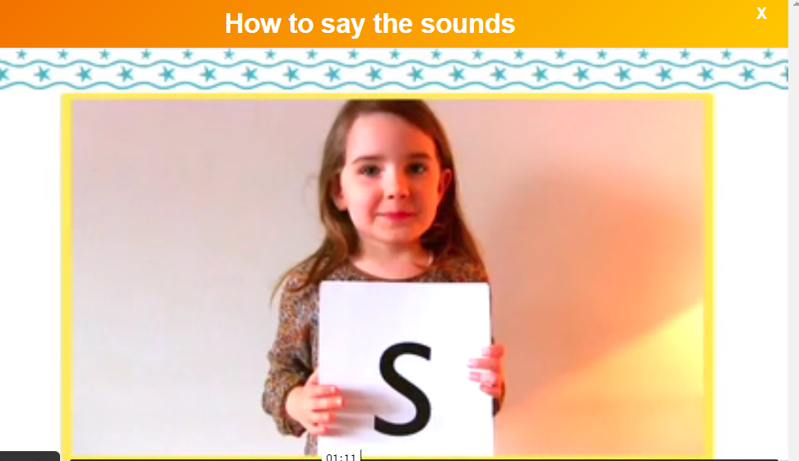
Gainsborough Primary & Nursery School
How do we say sounds correctly?

Slide 6
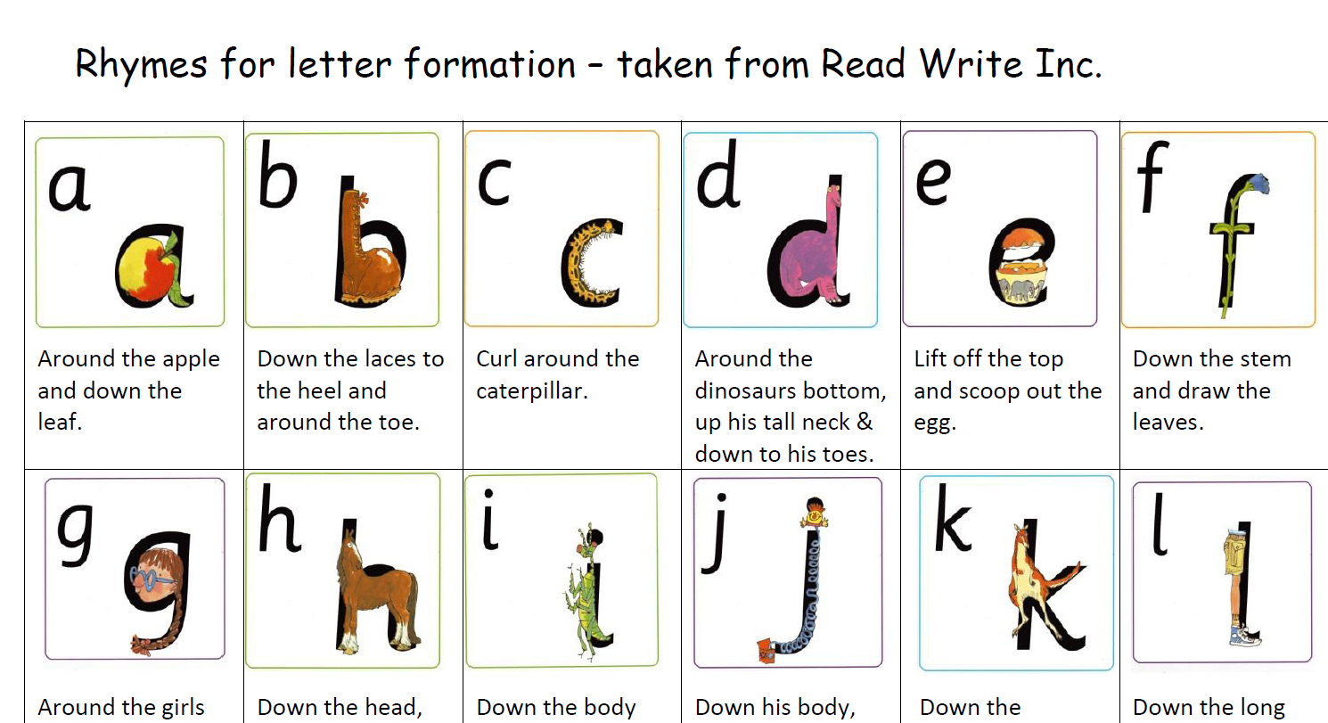
Gainsborough Primary & Nursery School
How can we remember the sounds?
See hand out showing different sounds and how we remember each one.

Slide 7
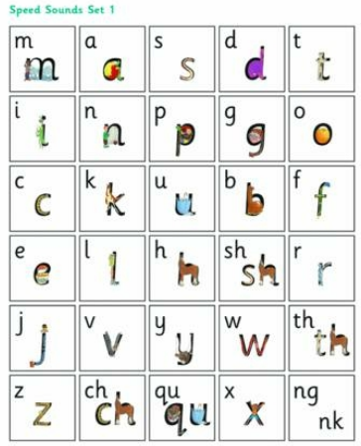
Notes:
We teach the children the key terminology of a phoneme and grapheme. A phoneme is the sound and a grapheme is the way the sound is written.
So we teach the children to look for digraphs and trigraphs basically two or three letters which make one sound.
These are the sounds that the children will need to know by the end of year one.
You have a sound strip in your pack.

Slide 8
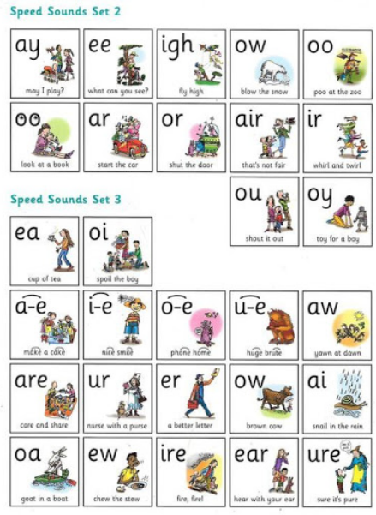
Notes:
We teach the children the key terminology of a phoneme and grapheme. A phoneme is the sound and a grapheme is the way the sound is written.
So we teach the children to look for digraphs and trigraphs basically two or three letters which make one sound.
These are the sounds that the children will need to know by the end of year one.
You have a sound strip in your pack.

Slide 9
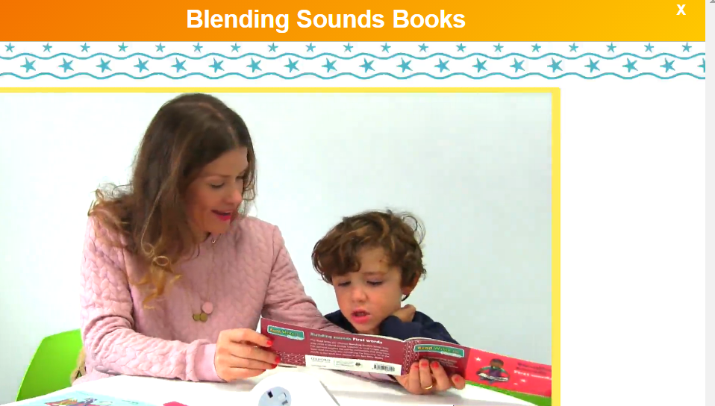
Gainsborough Primary & Nursery School
How can you help at home? First stage – blending

Slide 10
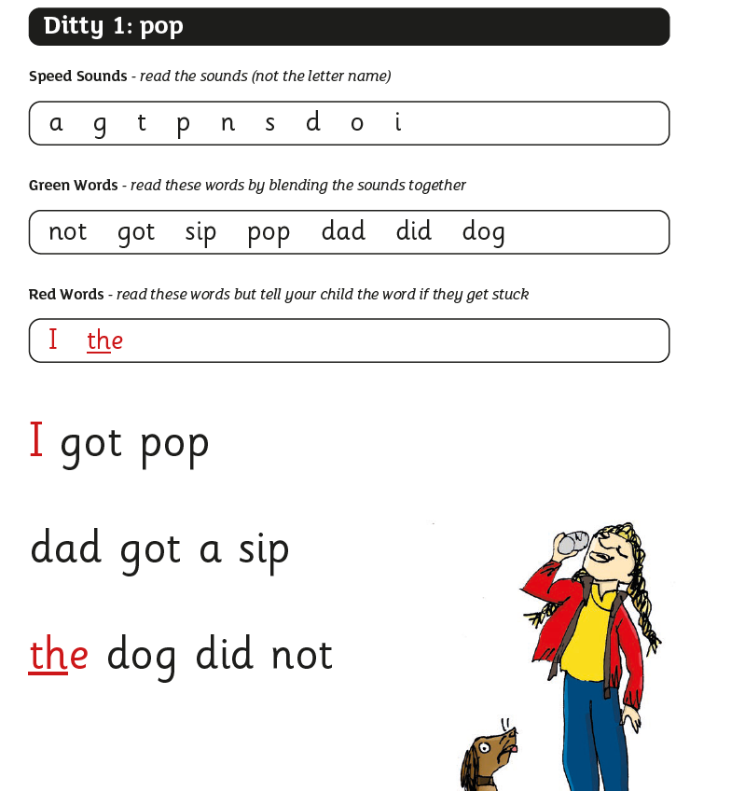
Gainsborough Primary & Nursery School
How can you help at home? Second stage– Ditty sheets
Ditty sheets are for when
your child has just learnt
to blend and is ready
to start reading a short ‘ditty’
Children will bring these home to
practise with you and these will
be changed regularly until they
are ready for the next stage.

Slide 11
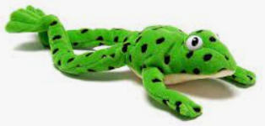
We teach the children to look for “special friends” within a word.
boat
much
Special friend, Fred talk, read the word
Notes:
We encourage the children to look for best friends- 2 or 3 letters together that make one sound.
When we do this we encourage sound buttoning

Slide 12
‘Chatty special friend’
Split diagraph
Cake
Shape
Notes:
We also teach the children split diagraphs by saying that the ‘e’ holds hands with the vowel and changes the sound.

Slide 13
Same letters, different
sounds!
mean
bread
Notes:
To make things tricky we have the same letters making different sounds. The children are taught to trial each one and see which sounds right.

Slide 14
Same sounds, different
letters!
may
make
pain
Notes:
We also have the same sound represented in different ways. The children will learn each way.

Slide 15
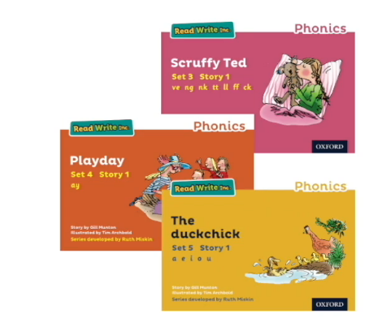
Gainsborough Primary & Nursery School
Wednesday 30th March 2022
How can you help at home? Third stage – books
Children will then move onto
books, which contain the sounds
they know. This helps them
become fluent and confident
readers so that they can
understand the texts they are
reading. Children will have books
at home for longer periods to
Ensure they are confident
storytellers until they move on.

Slide 16

Gainsborough Primary & Nursery School
Phonics Screening Check

Slide 17
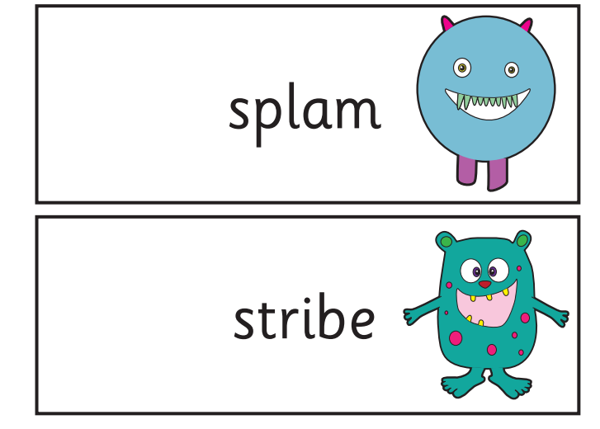
Phonics
Tests children's ability to decode (sound out words.)
Twenty real words and twenty nonsense words
The nonsense words will be clearly marked with a picture of an alien.
Notes:
As some of you may already be aware the children have to do a phonics test in June. The government introduced the Phonics Screening test in 2012 to test the children's ability to sound out words. They have to read 20 real and 20 nonsense words. (show booklet)
Nonsense words are included to test the children’s knowledge of sounds. It also means that they are new words to all children so all children across the country are tested fairly.

Slide 18
Websites
Ruth Miskin Website
https://www.ruthmiskin.com/parents/
https://www.phonicsplay.co.uk/

Slide 19
Spellings – Red words
Hide a word
Cut it up and stick it back together
Write with a stick in mud , in imaginary pen, with bath crayons or big chalks, on someone's back?
Anyway that you can think of!
Notes:
The spelling list for year 1 is in your pack. We are encouraging the children to have fun with spelling we are not going to check that they have copied it out ten times in their books!
Here are some ways we could think of to make spelling practise fun! Please let us know what exciting ways you think of.
They may benefit from writing the word in a sentence.

Slide 20



Handwriting
Notes:
We

Slide 21
Reading
Four times per week
Please sign reading records
Challenge – treat
Notes:
In order for our children to have the best possible opportunities to compete with their peers in later life we are asking that they read at home 4 times per week. This doesn’t have to be a lot and can involve you reading to your child and them answering questions.
Obviously we appreciate that life can be busy so this needs to be what works for you.
We joke with the children and say read to your grown up when they are washing up or to your baby/auntie/uncle/dog/cat!

Slide 22
Reading- Comprehension
In year two the children will be tested on their understanding of what they have read.
Notes:
In year two the children will be tested on their understanding of what they have read.
We would like to prepare the children in the best possible way so that they are not intimidated or worried by the written test by the time they reach year 2.
Show comprehension booklet. This is a great tool that we use lots in class to ask the children questions about what they have read or what we have read to them?

Slide 23
Reading
A page each
Where is the most exciting place you can read?
Under the stairs?
How many different people can you
read to in a month?
Notes:
You don’t have to sit and read with your child every day in the same way as we understand that sometimes it can be difficult to compete with playing. Reading needs to be fun and exciting.
We though of some ways to make reading interesting – Read slide.
We welcome any ideas you have to make reading fun and we will share them.

Slide 24
Questions
Comments
Feedback
Notes:
We will be hanging around after this meeting if you have any questions or would like to discuss anything with us.
As always we welcome your comments and feedback

Slide 25
Thank you!!
Notes:
A huge thanks for your time. It is greatly appreciated and we hope that you have found it useful.
PRINT FEEDBACK FORMS, PRINT PHONICS LEAFLET!! PRINT OFF PUPIL PREMIUM FORMS, PRINT OFF NEW PERMISSIONS FOR WEBSITE FORMS!!!!!

