Slide 1



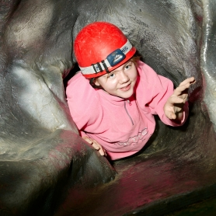
Gainsborough Residential 2024
Year 6
7th – 9th October 2024

Slide 2



Meet the team
Mrs Taylor
Mrs Kelly
Mrs Binner
Mr Simpson
The
Children!

Slide 3
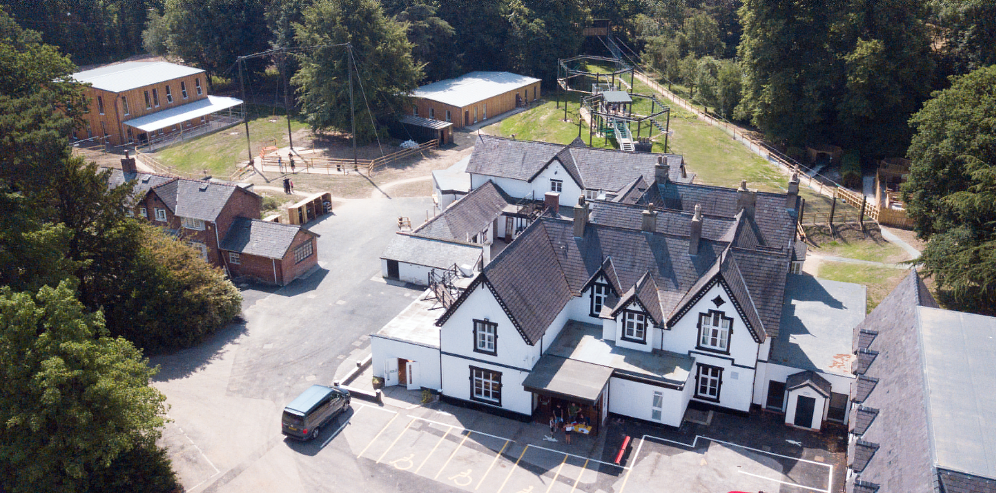
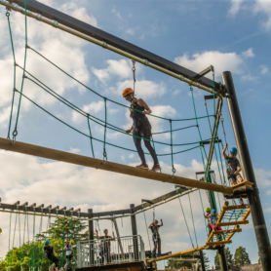

Where are we going?
Cross Lanes
Maes-Y-Nant
Wrexham

Slide 4
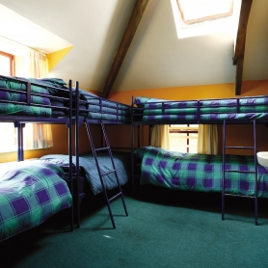
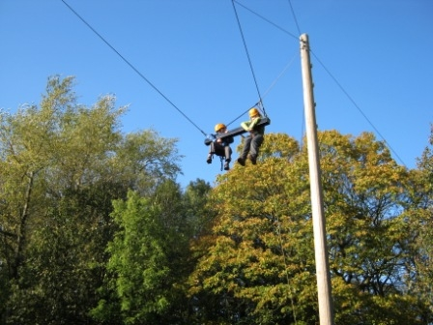
What happens when we get there?
Bedrooms
Lunch
Fire Drill
Familiarisation
Activities
Bedtime

Slide 5
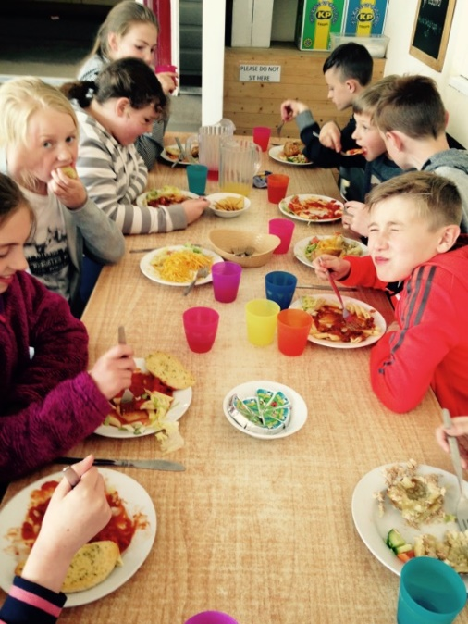
Meal times!
Breakfast
Lunch
Dinner
Snacks
Hot chocolate and biscuits
Fruit and water are always available

Slide 6
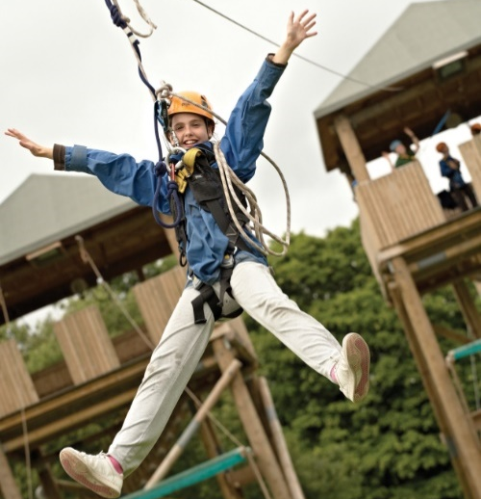

Activities
Giant swing
Crate challenge
Trapeze
Quest
Zip wire
Canoeing
Archery
High ropes
Night line
Obstacle Challenge
Caving
Team challenge
Climbing
Piranha Pool

Slide 7
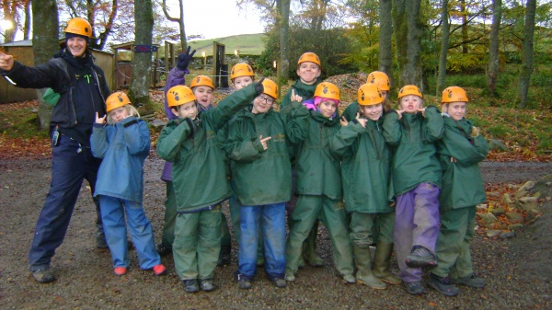


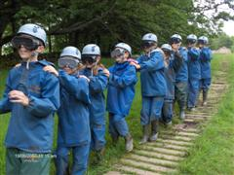
Developing Skills

Slide 8
Drop off at school!
On leaving day please bring your child to the small hall through this door between 8:40 and 8:50. No earlier!
Look for your group name and leave your bags there with your group leader (the children will be told this information nearer to the time).
Sign your child in at the registration desk.
Leave any medication and forms with us.
Make sure you say a ‘happy’ goodbye!
Plan what you’re going to do with your two nights off!!!!!!

Slide 9
Medication/Medical Info!
Please complete your medical forms tonight or as soon as possible.
Medication needs to be dropped off with a relevant form giving us permission to administer it.
Travel sickness pills – still need a form, ensure your child has taken them before coming to school and give the other one to us for the return journey!

Slide 10


Collection day!
Contact with
school.
We are due back before the end of the school day.
Children will be brought back into the small hall to collect bags and will be handed back to parents from here.
Children must be collected by an adult.
No one will be allowed to walk home by themselves.

Slide 11


What do we need to pack?
Kit list
Shoes
Coats (waterproof)
Toiletries
Towel
Please label EVERYTHING…. Even down to bags and underwear!
Make sure your child is involved so they know what is in there!

Slide 12
Any Questions?

