Slide 1

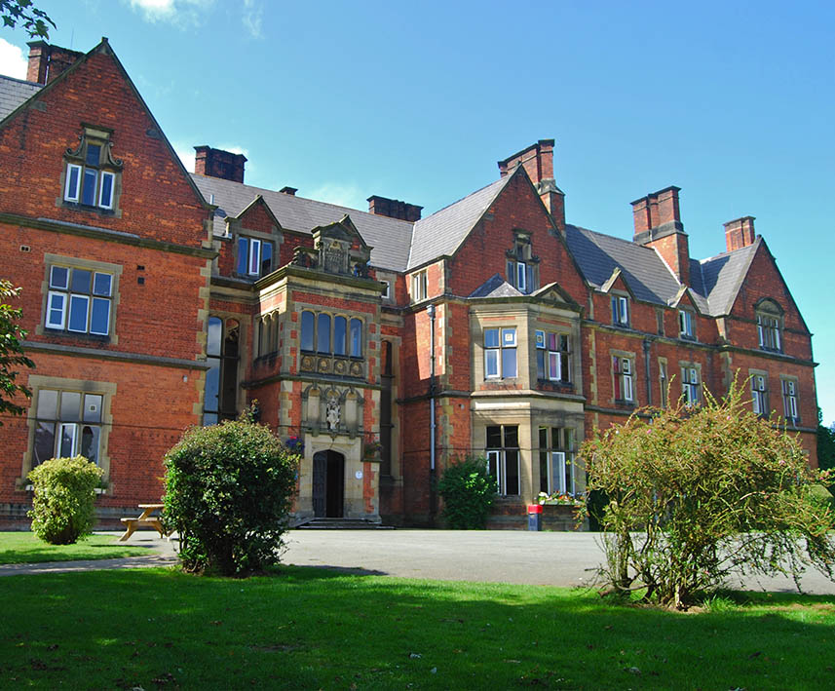
Boreatton Park
Shropshire
12th – 13th March 2025

Slide 2
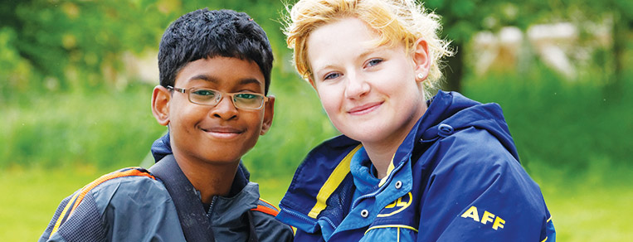




Welcome to PGL
The UK’s largest provider of outdoor education for young people
Over 55 years’ experience
Fully risk assessed
LOtC Quality Badge holder
Notes:
PGL provides a wide range of inspiring residential adventure and educational courses for more than 5,000 groups every year
All PGL centres and activities are risk assessed to comply with legal requirements and best practice. Risk assessments are available by request and on the PGL website
Centres are subject to the Adventure Activities Licensing Authority regulations (AALA) where appropriate
ABTA (Association of British Travel Agents) bonded means your money is protected
BAPA – British Activity Providers Association. Responsible for establishing operating guidelines for the activity holiday industry
Through the Learning Outside the Classroom Quality Badge Programme you can be confident that recognised providers fulfil all the necessary criteria as laid down by the DfE, thereby better enabling Party Leaders to manage visits safely, efficiently and beneficially

Slide 3
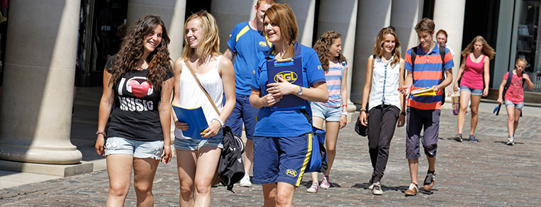
The PGL difference
Dedicated PGL Tour Leader to provide support throughout stay
Wide range of on-site adventure activities
Evening entertainment
24 hour support from centre team
Notes:
Your PGL Tour Leader will have a wealth of local knowledge so you can make the most of your time away.

Slide 4
Meet the team
Miss Gough
Mrs Watson
Mrs Turner
Mrs Binner
The
Children!

Slide 5
Drop off at school!
On leaving day please bring your child to the small hall through this door between 8:35 and 8:45. No earlier
Sign your child in at the registration desk.
Leave any medication and forms with us.
Make sure you say a ‘happy’ goodbye!
Plan what you’re going to do with your night off!!!!!!

Slide 6
Medication/Medical Info!
Please make sure you have collected a medical form; please complete tonight or return as soon as possible.
Medication needs to be dropped off with a relevant form giving us permission to administer it.
Travel sickness pills – still need a form and giving to us for the return journey.

Slide 7
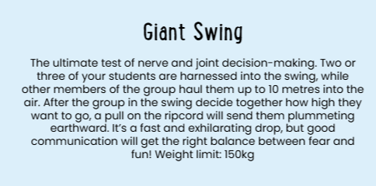
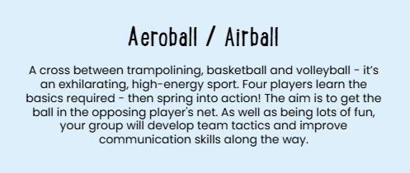
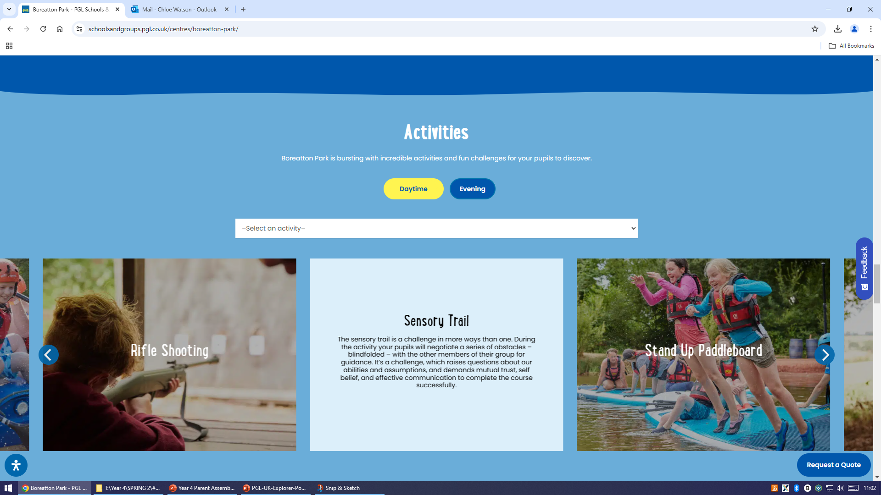
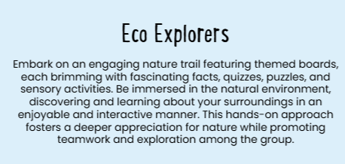
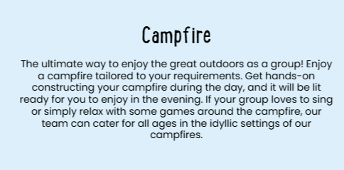
Our Activities

Slide 8
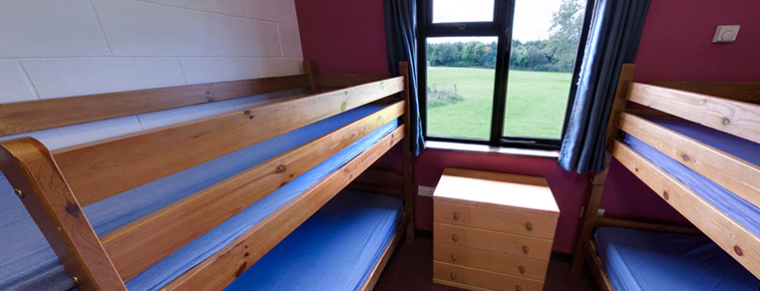

Accommodation
Mansion House – rooms sleep 8-14 with nearby facilities.
All children to bring a pillow and sleeping bag/duvet.
Accommodation for Boreatton Park can be viewed in the 360 virtual tour: www.pgl.co.uk/boreatton360
Notes:
The centre can accommodate 916 guests at a time with accommodation in the mansion house, lodges or tents in the summer
Teachers are usually accommodated in twin rooms with en suite and hot drink facilities
All rooms are lockable (party leader given master key)
All exterior doors and gates are locked at night but can be opened from the inside in an emergency without the need for unlocking
A PGL staff member is available on duty throughout the night (contactable by phone)
The extensive facilities (other than activity bases) are available to your group during free time

Slide 9
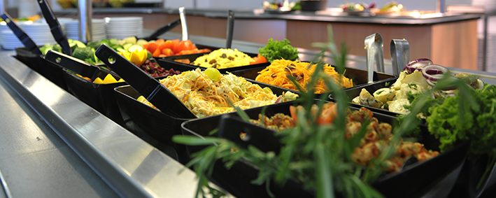
Catering and dietary needs
You need to provide your child with a packed lunch for Wednesday.
3 nutritious, balanced meals per day
Self-service salad bar
Vegetarian option
Special diets catered for by prior arrangement
Alternatives can be provided if necessary
Sample menus available online: www.pgl.co.uk
Notes:
We continually invest in healthy menus with freshly cooked ingredients obtained from fully traceable audited suppliers
Processed food is avoided and meals meet Local Authority guidelines
There will be hot and cold options available at every meal
At lunch and dinner the buffet includes a salad bar and mixed fruit basket plus hot and cold drinks
Our caterers can deal with most dietary requirements but please ensure the party leader is aware of any dietary requirements well in advance
More food is always available if required

Slide 10
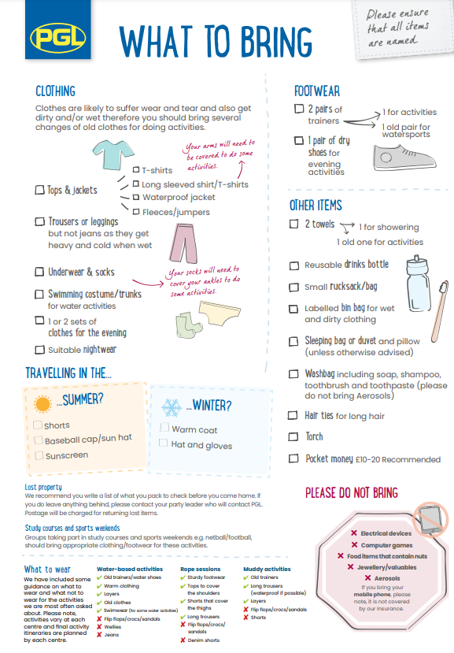
All children will need to bring a sleeping bag/duvet and a pillow
There will be NO water based activities
Please provide your child with a packed lunch for Wednesday. This needs to be kept separate from their overnight bag.

Slide 11
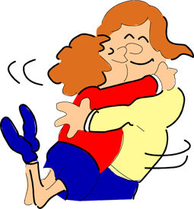
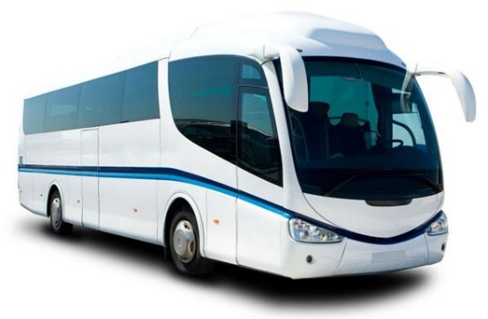
Collection day!
Contact with school.
Due back before the end of the school day.
Children will be brought back into the small hall to collect bags and will be handed back to parents from here.
Children must be collected by an adult.

Slide 12
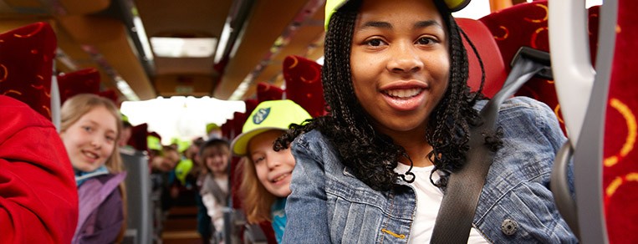
Thank you for listening
Any questions?
Notes:
Questions?

