Slide 1





@TTRockStars
ttrockstars.com

Slide 2
What is TTRS?
Times Table Rockstars is an award winning maths programme with a rockstar theme, designed by maths teachers to help children learn their times tables.
Available in paper format, online and via an app (accessible both at school and at home).
Times Table Rockstars successfully gamifies times tables and equips young people with secure numeracy and arithmetic skills and a confidence in maths

Slide 3
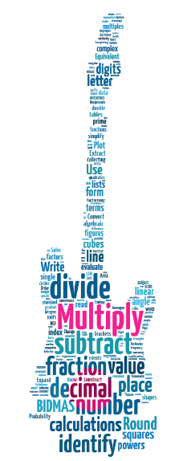
Why do children need to know their times tables?
Times tables are often a sticking point in maths. As teachers, we often remind children that knowing their times tables will help in many other subject areas, including fractions, area, algebra, and ratio.
Not only this, but it helps in day to day life – e.g., going shopping.
@TTRockStars
ttrockstars.com
Notes:
This is saying largely what the previous slide but with a different image.
You might be interested to know that the word cloud was based on an analysis of GCSE topics by Will Emeny (Great Maths Teaching Ideas). The thing that came out on top (in terms of direct and indirect application in GCSE maths) was times tables. Nearly 60% of GCSE topics could be traced to a root in times tables.

Slide 4
What times tables should you be teaching?
Y1 – Counting in 1s
Y2 – 2s, 3s, 5s, 10s
Y3 – 3s, 4s, 8s
Y4 – 6s, 7s, 9s, 11s, 12s (MTC June)
Y5 – Consolidation
Y6 – Consolidation Really important

Slide 5
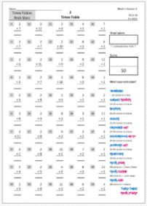
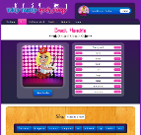
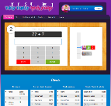
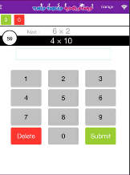
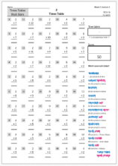
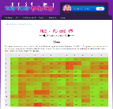
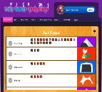

Three Modes
Lesson 1
Lesson 2
Lesson 3
Lesson 4
Lesson 5
Paper
Website
App
@TTRockStars
ttrockstars.com

Slide 6
Paper
These are all readily available online
Worksheets cater for all tables up to 12
Offer different styles of questions
Can be used as additional homework
Could be snipped and used on daily dashboard or in key skills

Slide 7



















Website
•
1 minute games
Single player
Or
Multi-player
Earn & spend on your avatar
@TTRockStars
ttrockstars.com

Slide 8
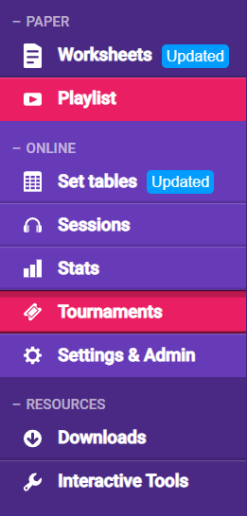

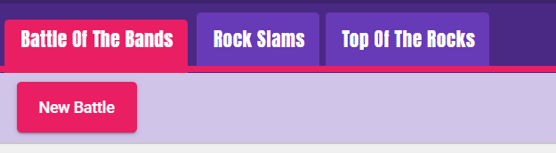
You can take part in competitions and challenges!
Enjoy!
@TTRockStars
ttrockstars.com

Slide 9



App
Earn & spend on your avatar
Single player
Or
Multi-player
•
1 minute games
@TTRockStars
ttrockstars.com
Notes:
Show this slide instead of slide 17 if you’re going to be using the app rather than the website.
Remember, to use the app, your school must have the Mobile Apps bolt-on. Go to Subscription Details once you’ve logged in to find out if you have it enabled.

Slide 10
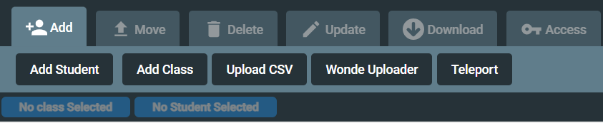
Log in/password
You should all have a username and password for TTRS.
Zoe sent out emails to all new members and support staff.

Slide 11
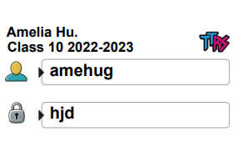
Classes 22-23
I have created new classes for you all.
You need to log on and add your pupils – this should take 10/15min maximum.
Once you have added your whole class, you can export their login in details.
Print these off and stick them in their reading diaries.

Slide 12
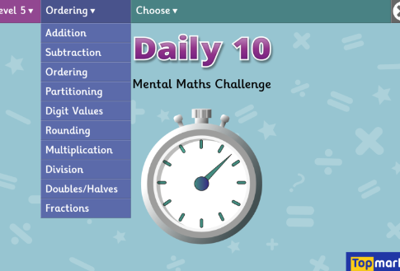
Daily 10
Daily 10/ top marks top ten
Singing/chanting
Test children daily
Children have to answer questions in a certain time frame
Evident in maths books
Weekly focus
Different levels of difficulty
https://www.topmarks.co.uk/maths-games/daily10

