Slide 1
Monday 5th January 2026

Slide 2

Phonics
Can you sing the tricky word songs?
Maybe you might like to make your own Red Word cards with the tricky words on them.
https://www.youtube.com/watch?v=TvMyssfAUx0
https://www.youtube.com/watch?v=R087lYrRpgY

Slide 3
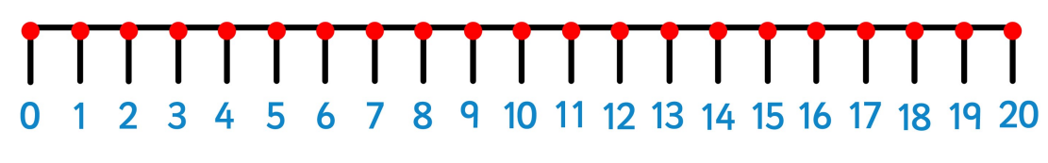
Maths
In Maths we are going to be looking at numbers to 20.
Can you create a number line to 20?

Slide 4
Can you count the following things in your house?
Windows
Doors
Teddies
Chocolate bars
Cushions
Plants
Things with plugs
Choose your own things to count ☺

Slide 5
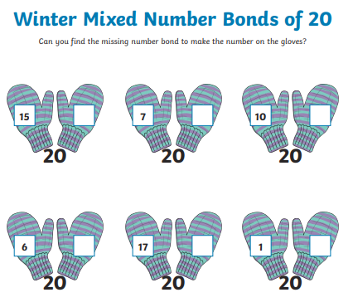
Can you find the missing numbers to make 20?

Slide 6
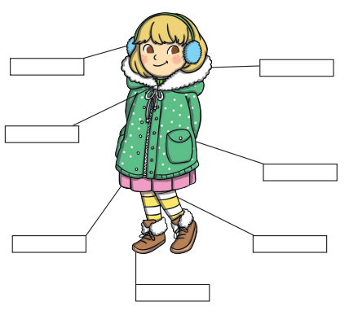
English
Write a list of things you can see out of your window.
Draw and label what you will wear outside in the snow.

Slide 7
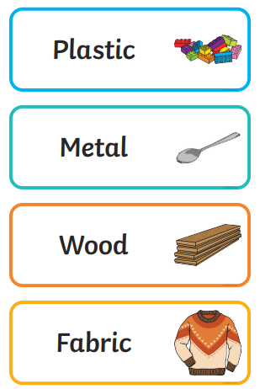
Science
We are going to be learning about what things are made from.
Can you find things made of the different materials in your house?
Draw pictures or make a list.

Slide 8

Snow Fun
Go outside and take pictures of everything you see!
Build a snowman and take a picture to show us all!.

