Slide 1
Monday 5th January 2026
Happy New Year to you all.
We are sorry that school is closed today. Please find below some activities to complete.

Slide 2
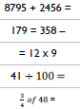
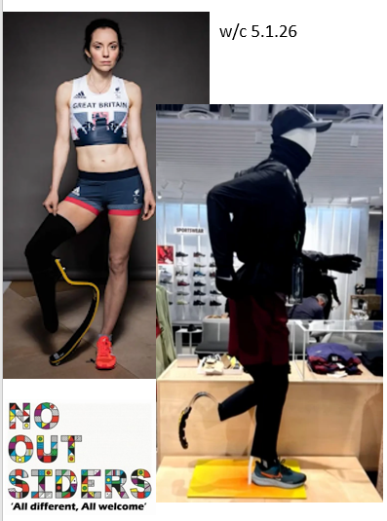

5.1.26 Daily Dashboard
Words of the week
referring preferred
transferring reference
What do these words mean?
Write out the sentences with correct punctuation:
No outsiders
What is a bladed mannequin? Why do you think Stef wishes she had seen these when she was little? How do you think Stef might have sometimes felt about her different leg as a little girl?

Slide 3

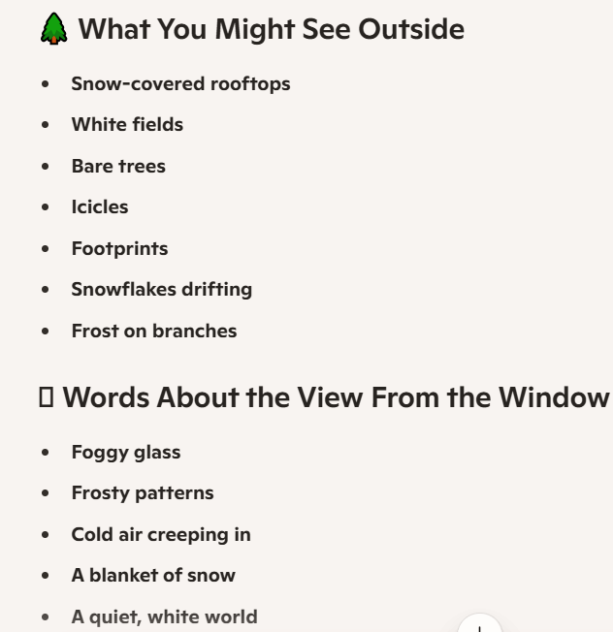
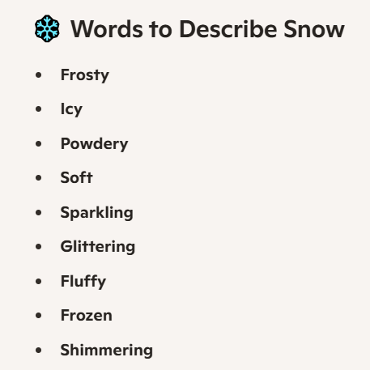
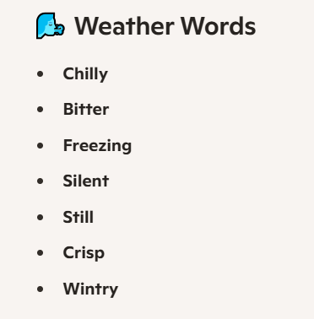
ENGLISH:
Go outside and take pictures of everything you see!
Build a snowman and take a picture to show us all!
Describe the view from your window using imaginative vocabulary:

Slide 4
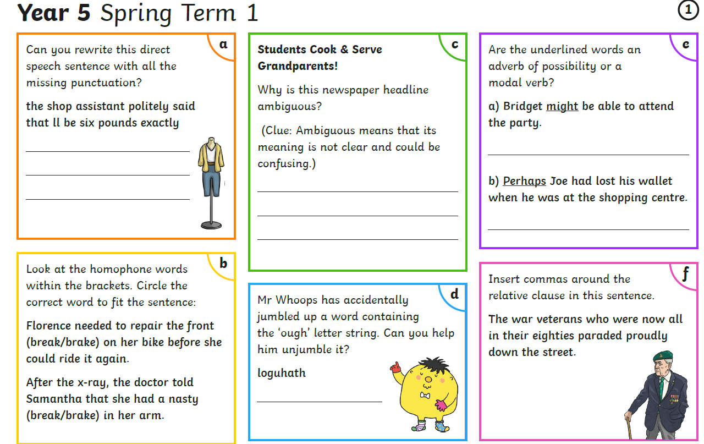

Slide 5
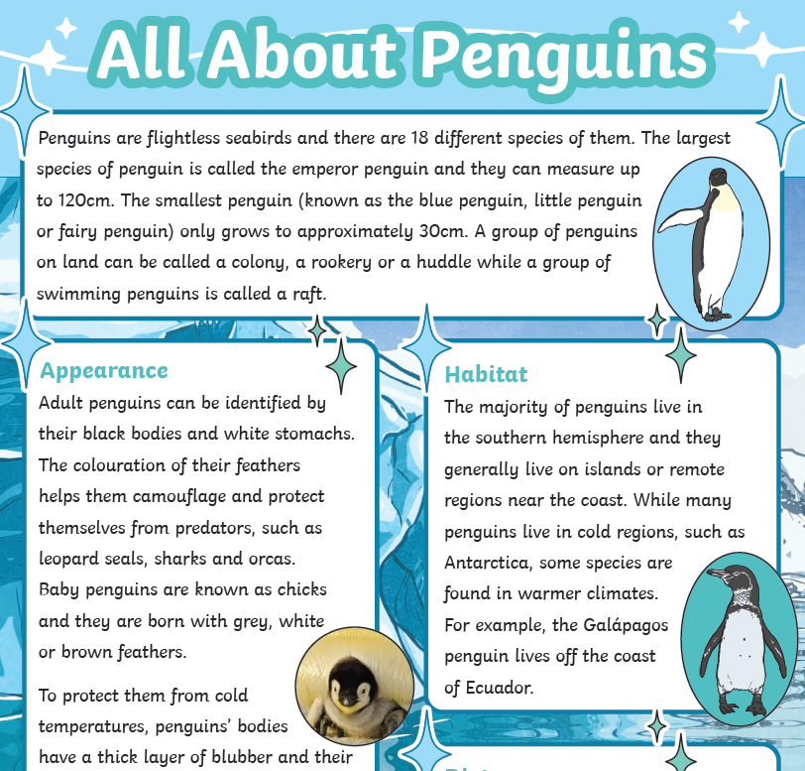
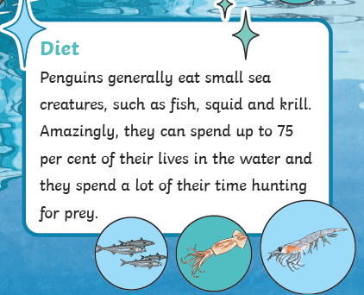
Reading comprehension:

Slide 6
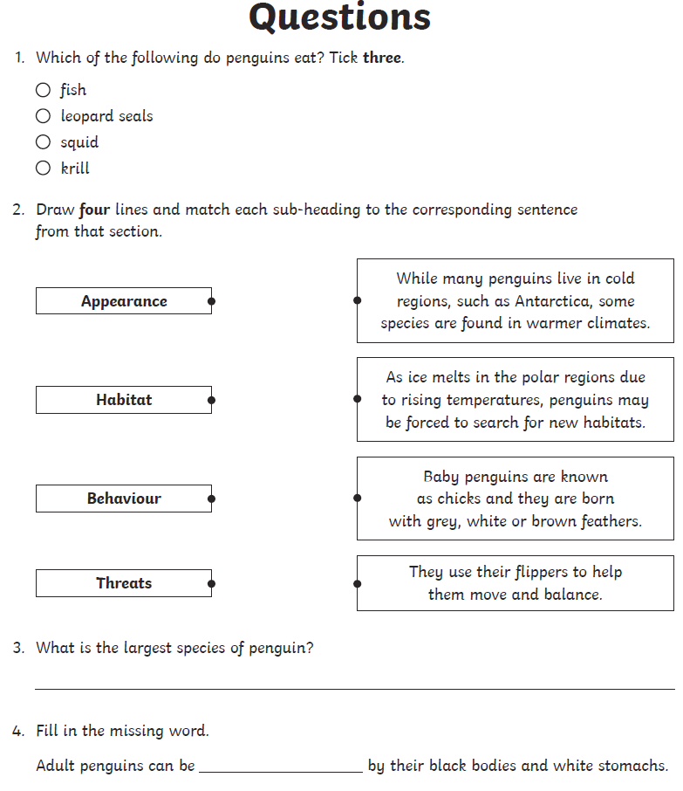
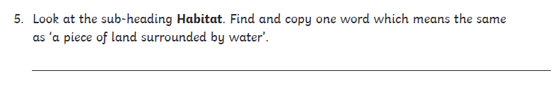
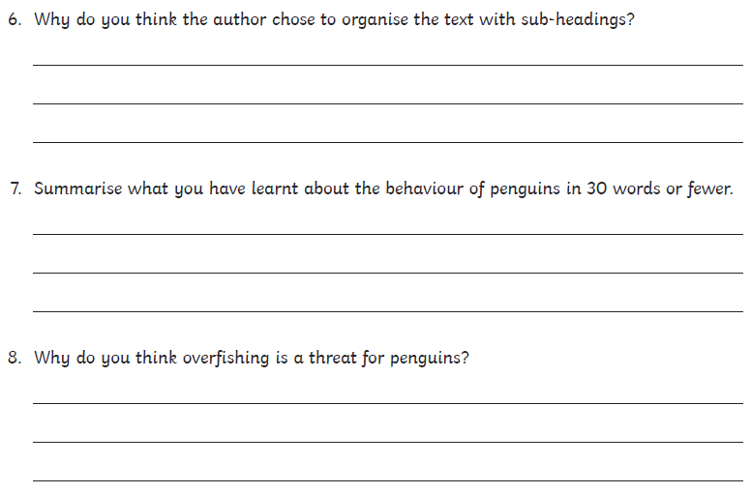

Slide 7
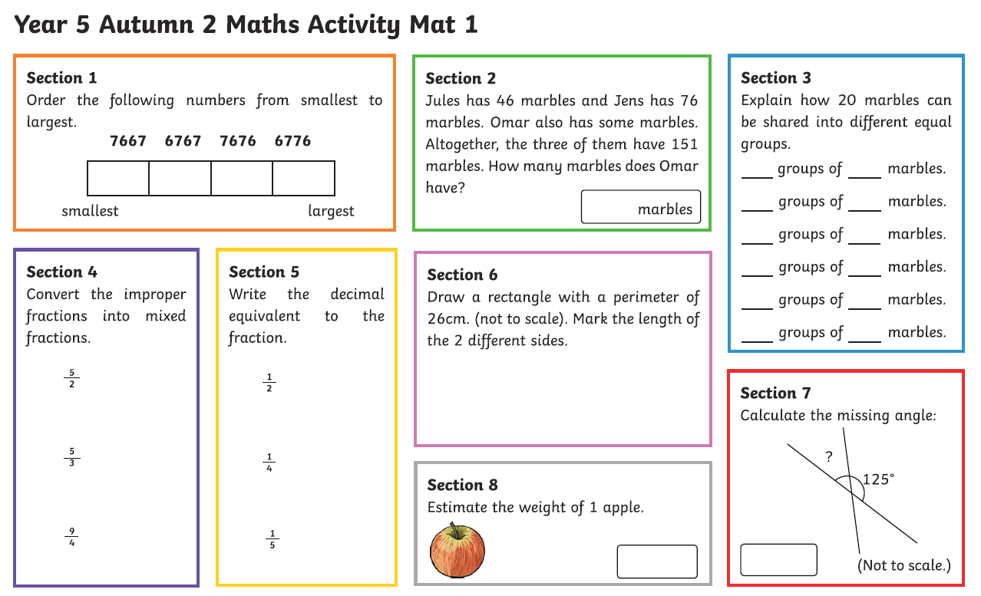
Maths-
Log in to Times Table Rockstars and practise your times tables and speed.
How many 2s in 5?
How many left over?
5/2 = 2 and ½
The two angles need to equal 180 degrees

Slide 8
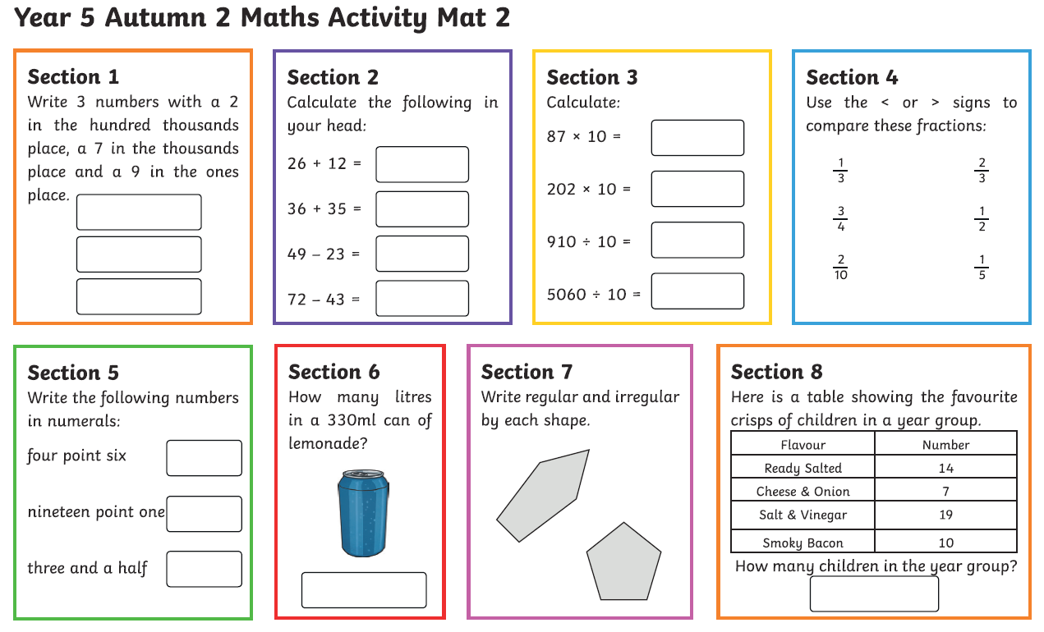

Slide 9
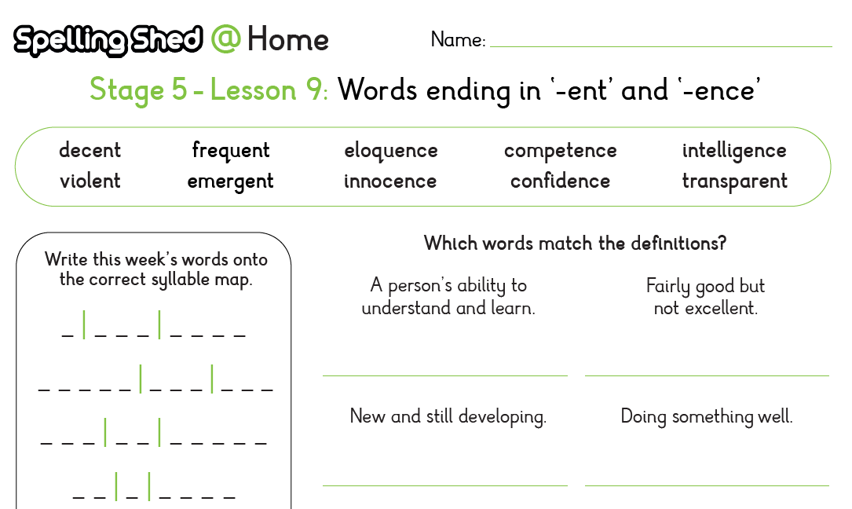
Spelling:

Slide 10
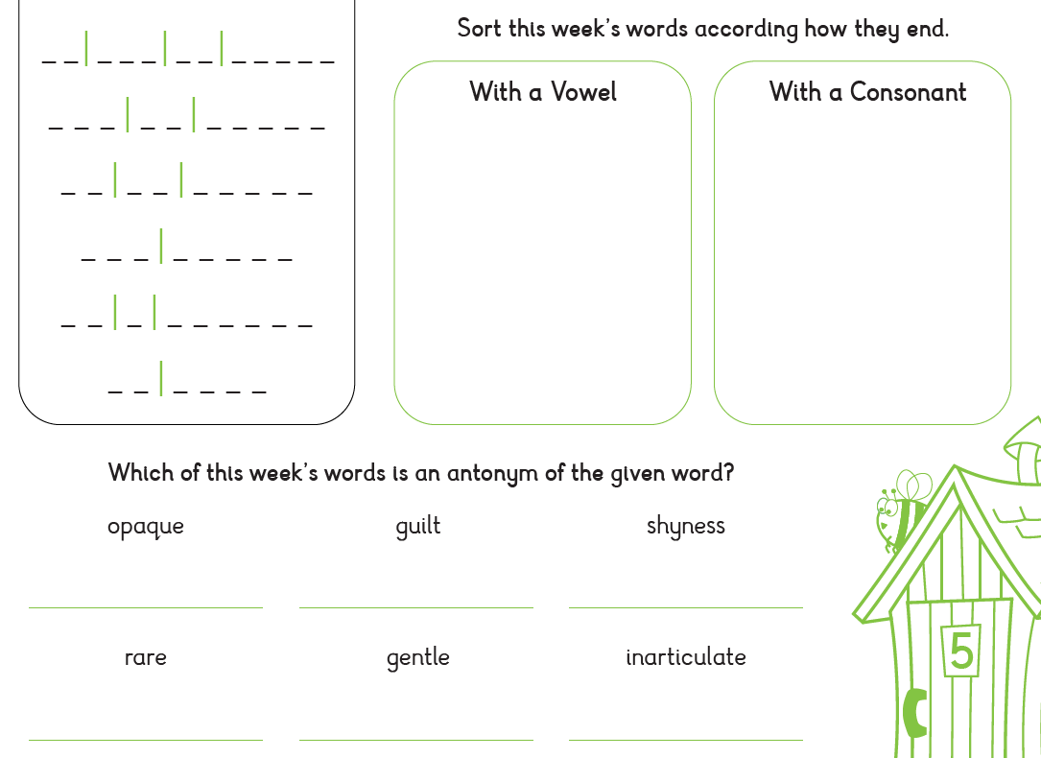

Slide 11
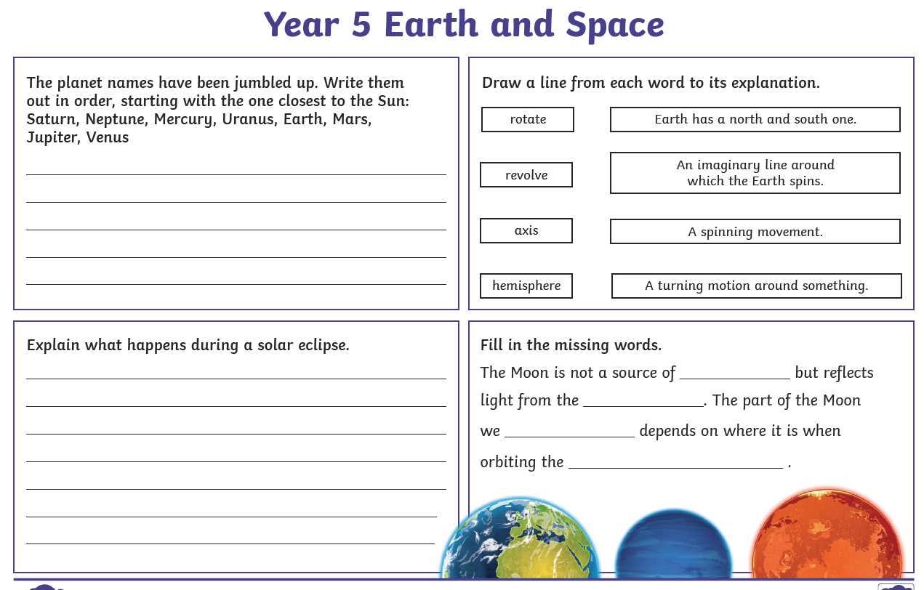
Science:

Slide 12
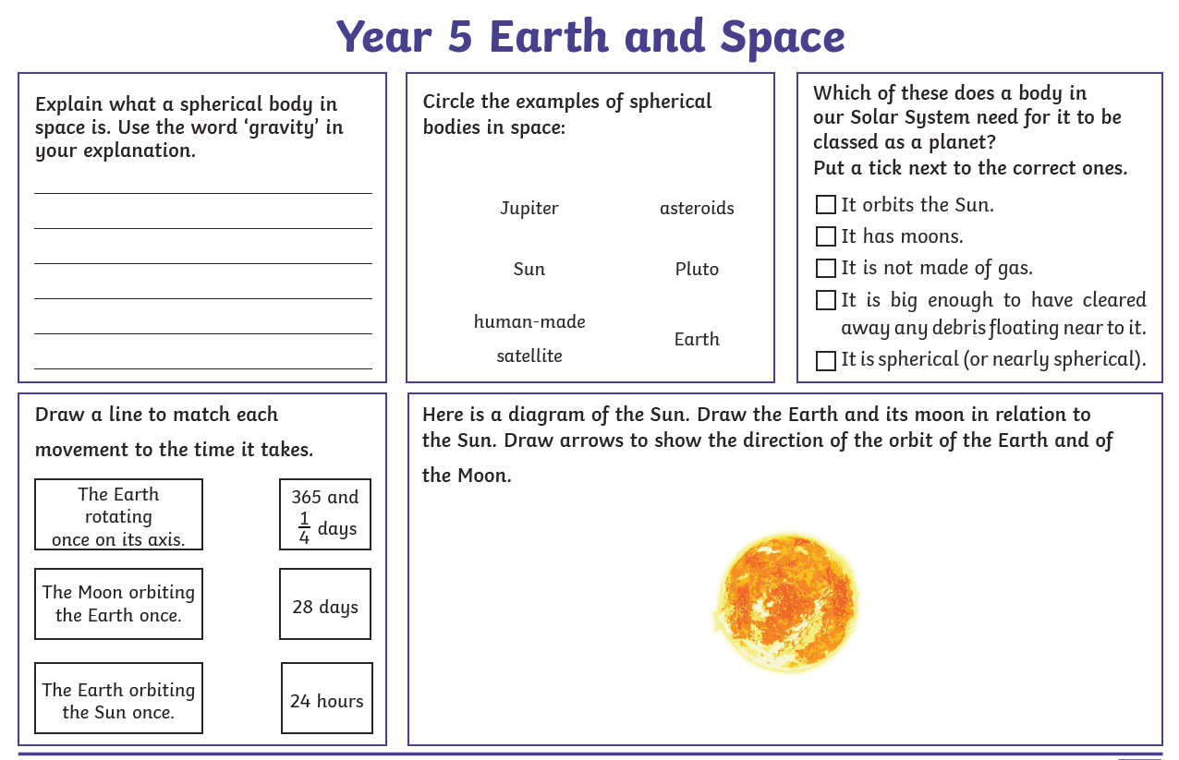

Slide 13
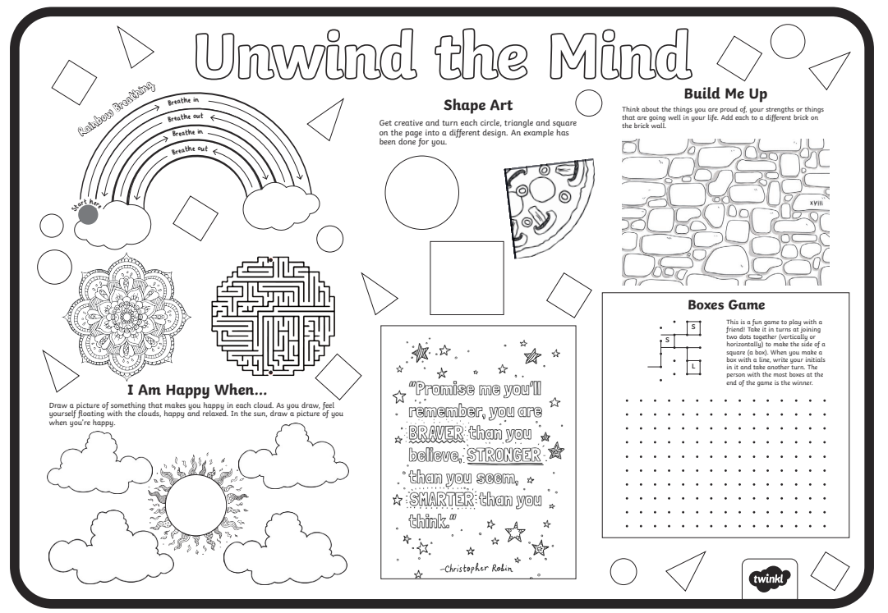

Slide 14
