Slide 1
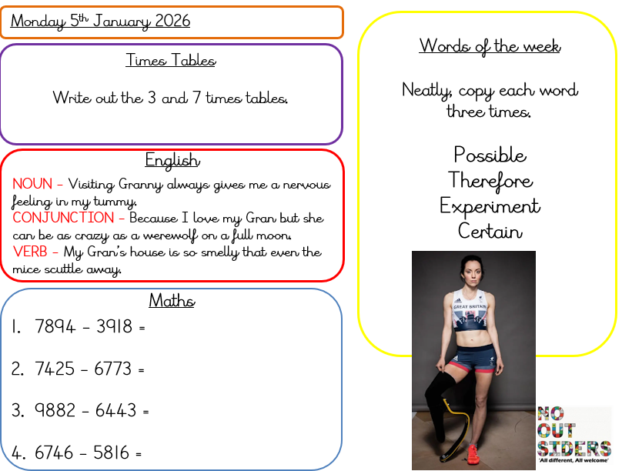
Monday 5th January 2026

Slide 2
Maths
Practise your multiplication skills skills using TT Rockstars or this game…
https://www.topmarks.co.uk/maths-games/hit-the-button

Slide 3
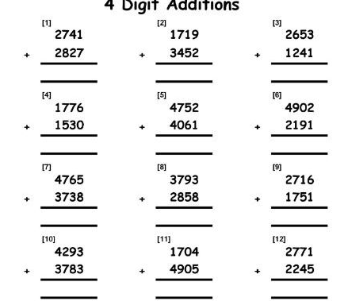
Maths

Slide 4
English
Practise your S.P.A.G skills using this fun and interactive game.
https://www.bbc.co.uk/bitesize/topics/zbghcxs/articles/zbm8scw

Slide 5
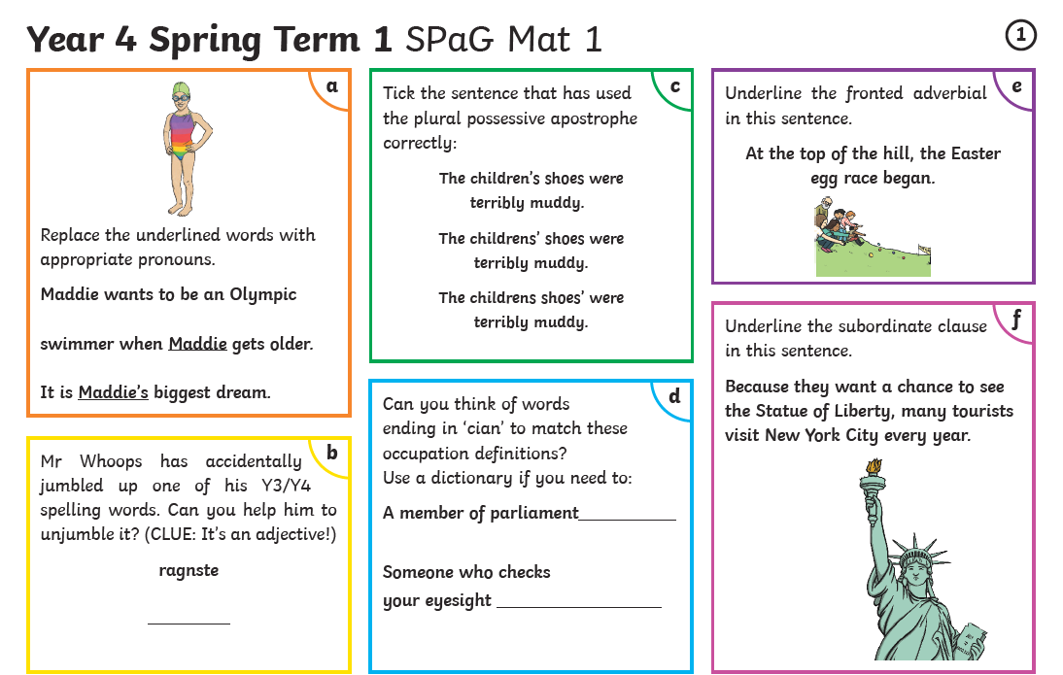
English
Complete the S.P.A.G.

Slide 6
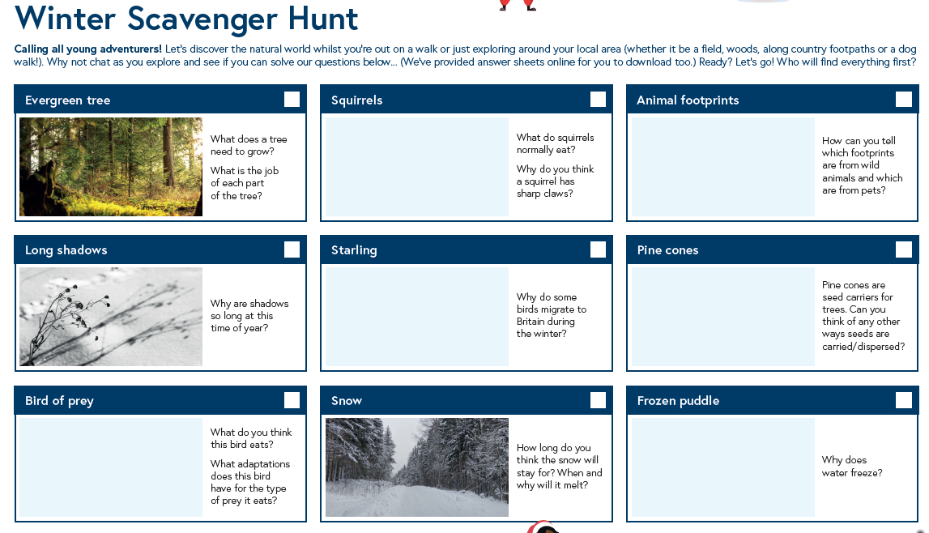

Slide 7

Go outside and take pictures of everything you see!
Build a snowman and take a picture to show us all!.

