Slide 1
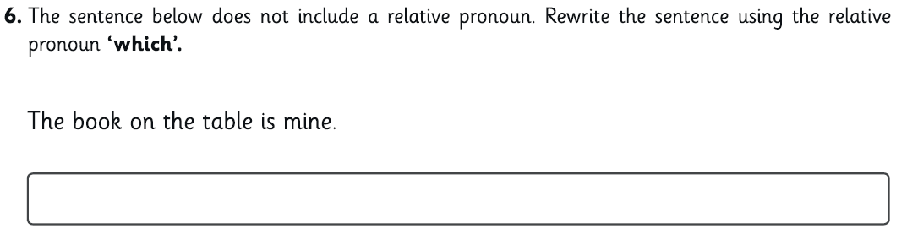
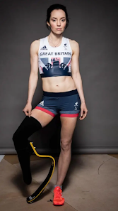
Monday 5th January 2026
1. | 707 + 1,818 = | 5. | 0.9 X 10 =
2. | 505 ÷ 1= | 6. | 418 X 46 =
3. | 8 X 33 = | 7. | 50 + (36 ÷ 6)=
4. | 4 + 3 = 6 6 | 8. | 62 - 38 = 100 100
The picture shows Stef Reid who is a world champion Paralympic long jumper and sprinter for Canada and Great Britain. She is a multiple medal winner and also has a MBE. Today Stef campaigns for Nike, Adidas and Puma to do something different... Lots of stores proudly display models with blades in their shop windows. Stef thinks this is great and wishes she had seen these in shops when she was little.
High end running shoes cost over £200 but Stef only needs one. Stef has to buy two shoes even though she only uses one shoe.
Stef is campaigning for Nike, Adidas and Pumas to sell single shoes.
Spellings: Write each word out x3 times; check you have spelt the words correctly!
occupy
pronunciation
according
frequently

Slide 2
Maths
Practise your maths skills using this game…
https://www.bbc.co.uk/bitesize/topics/zd2f7nb/articles/zn2y7nb#zj6v6rd

Slide 3
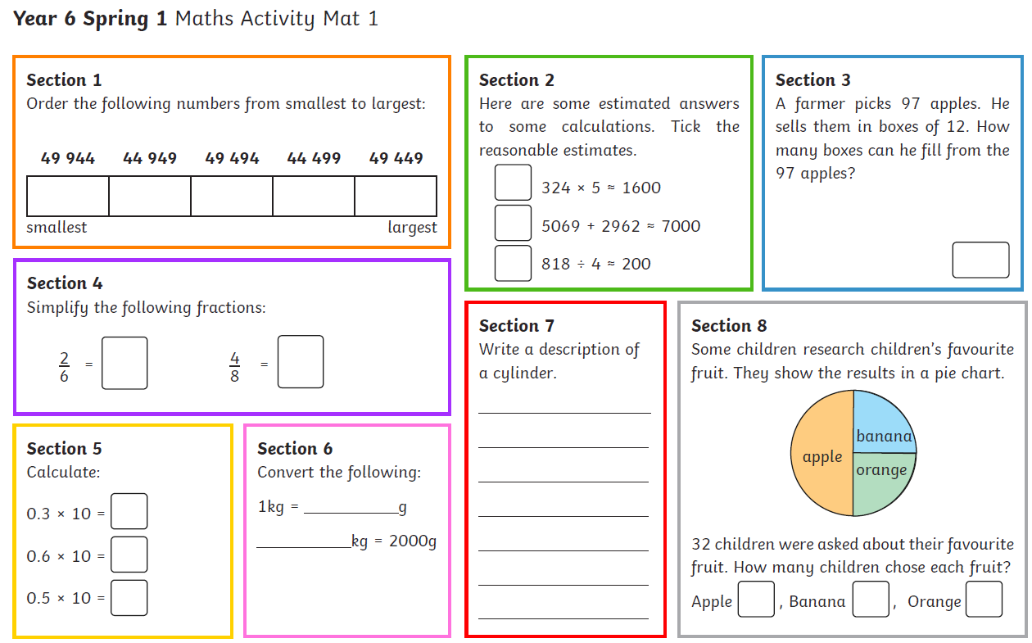
Maths

Slide 4
English
Practise your S.P.A.G skills using this fun and interactive game.
https://www.bbc.co.uk/bitesize/topics/zbghcxs/articles/zbm8scw

Slide 5
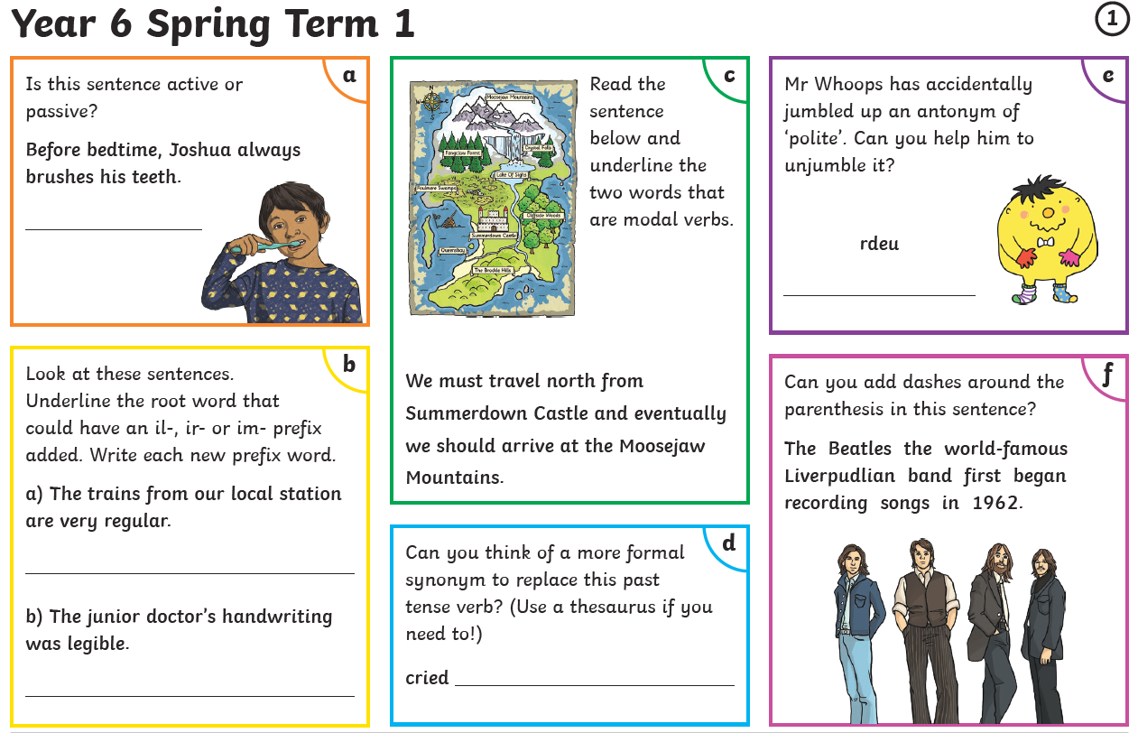
English
Complete the S.P.A.G.

Slide 6

Spelling
Go onto Spelling Shed. Complete your assignments.
Spend 15/20 minutes on the spelling game ‘Beeseiged’

Slide 7
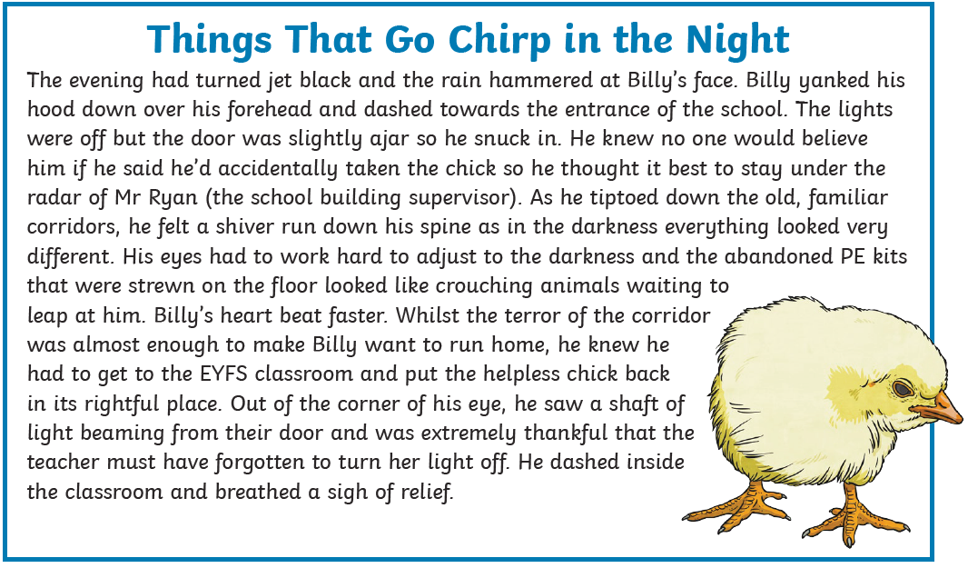
Reading Comprehension
Read the following text and answer the questions on the next slide.

Slide 8
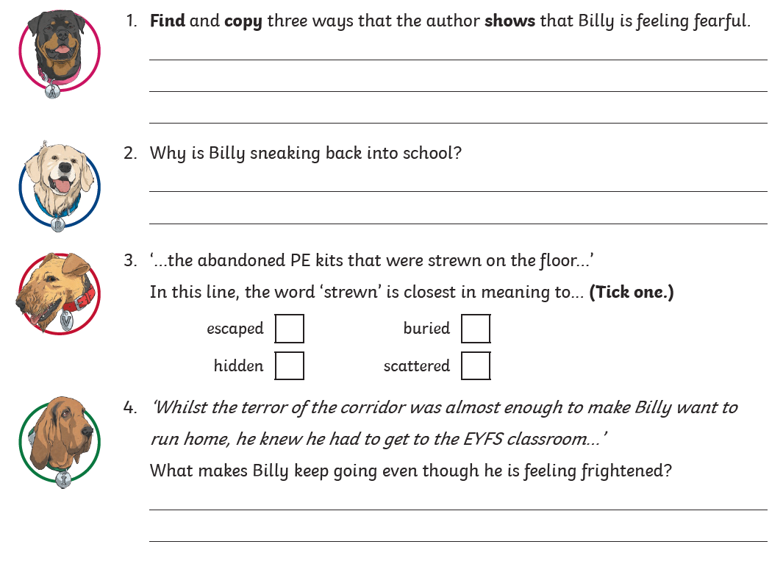

Slide 9
Computing/History
Sign onto PurpleMash and complete your ‘To do’.
You will be comparing the Maya game of Pok a Tok to football.

Slide 10
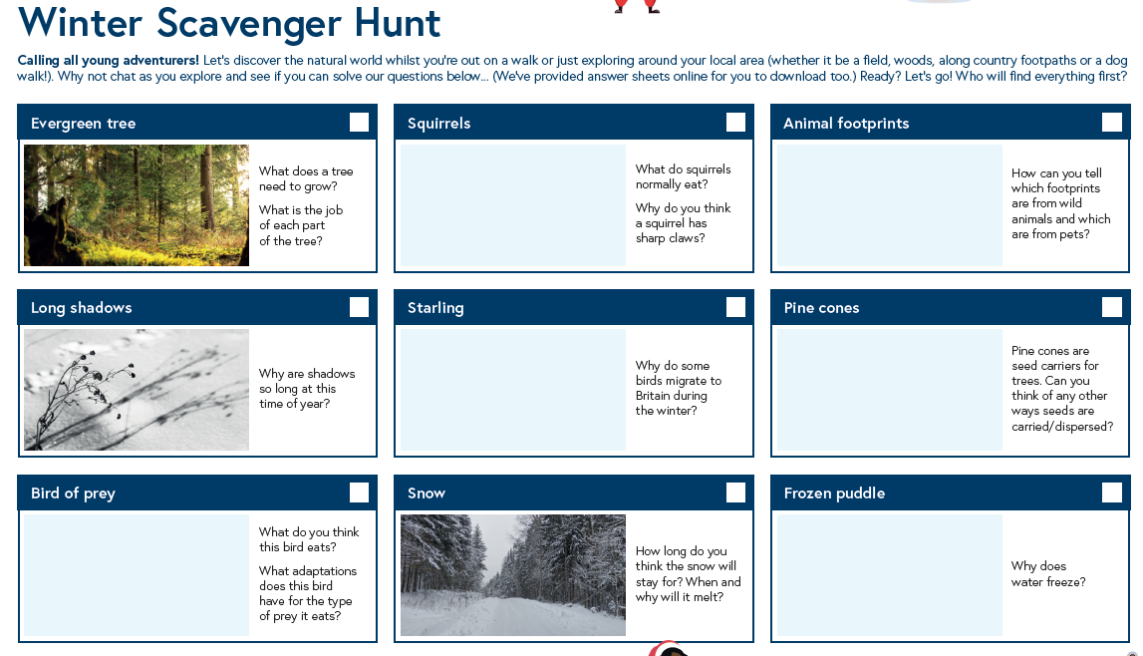

Slide 11

Go outside and take pictures of everything you see!
Build a snowman and take a picture to show us all!.

