Slide 1
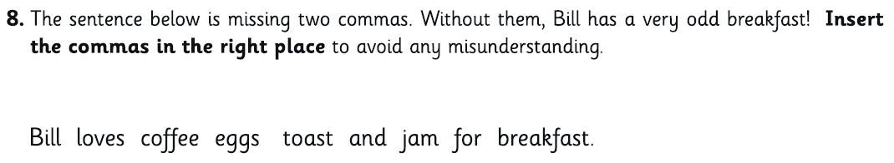
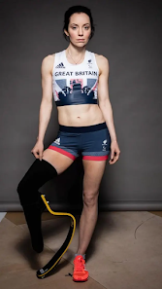
1. | 761 + 3,218 = | 5. | 2.7 X 10 =
2. | 505 ÷ 5= | 6. | 321 X 23 =
3. | 8 X 62 = | 7. | 20 + (24 ÷ 4)=
4. | 4 + 3 = 7 7 | 8. | 15 + 20 = 50 50
Tuesday 6th January 2026
Spellings:
Put the words below into alphabetical order:
occupy
pronunciation
according
frequently
What is a bladed mannequin? Why do you think Stef wishes she had seen these when she was little? How do you think Stef might have sometimes felt about her different leg as a little girl?

Slide 2
Maths
Practise your maths skills using this game…
https://www.bbc.co.uk/bitesize/topics/zd2f7nb/articles/zn2y7nb#zj6v6rd

Slide 3
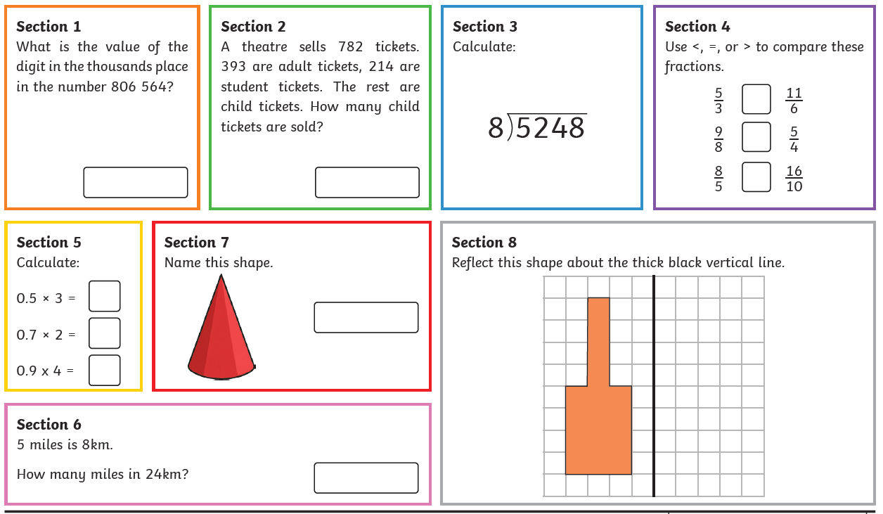
Maths

Slide 4
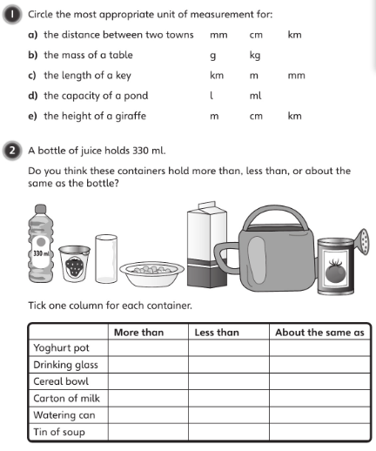
Answer these questions on a piece of paper or in a book. Be careful with the unit of measurements!
Consider these conversions
10mm = 1cm
100cm = 1m
1000m = 1km
1000g = 1kg
1000ml = 1l

Slide 5
English Practise your S.P.A.G skills using this fun and interactive game.
https://www.bbc.co.uk/bitesize/topics/zbghcxs/articles/zbm8scw

Slide 6
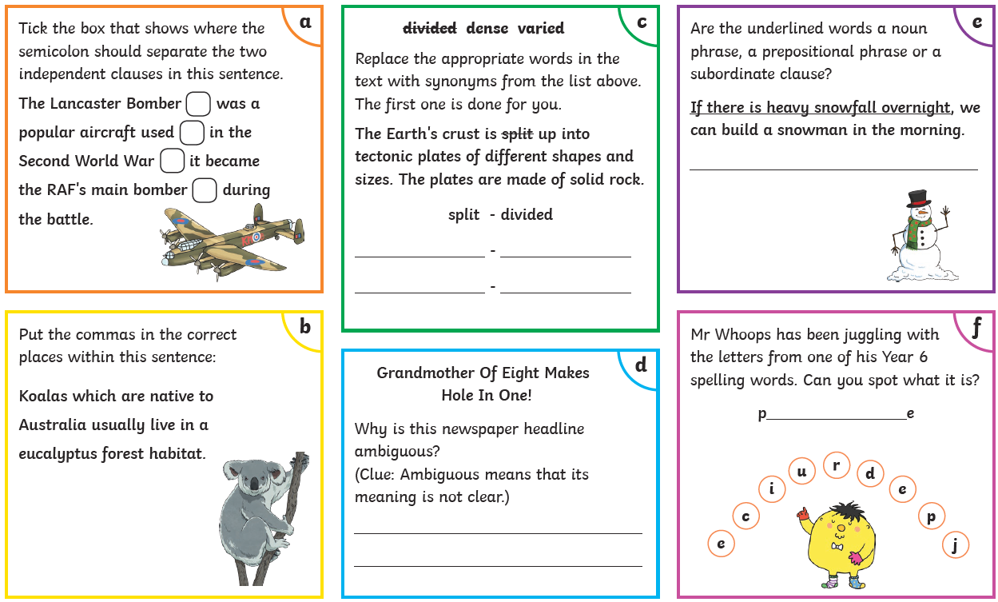
English Complete the S.P.A.G.

Slide 7

English
Visit Purple Mash and complete at least two of the activities set.

Slide 8
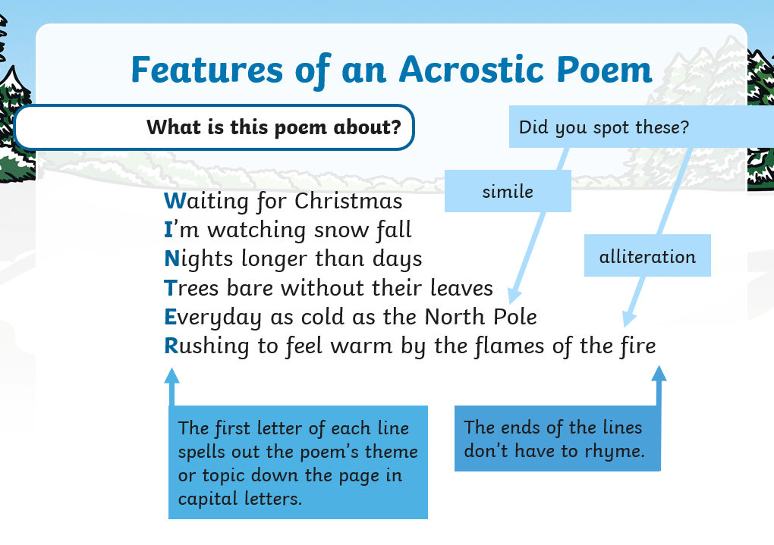
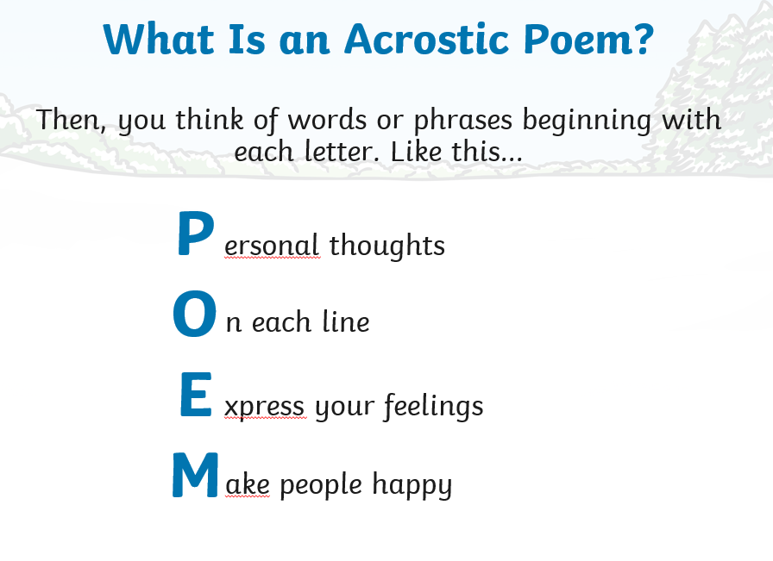
English – Write a winter themed acrostic poem…

Slide 9
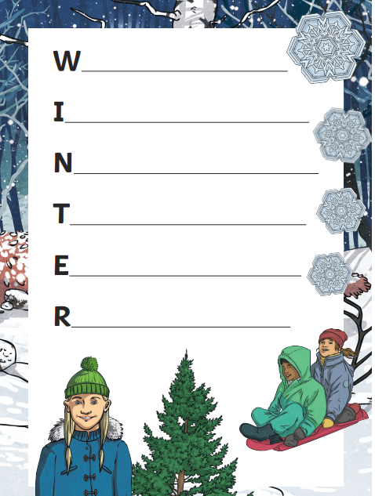


Slide 10

Spelling
Go onto Spelling Shed. Complete your assignments.
Spend 15/20 minutes on the spelling game ‘Beeseiged’

Slide 11
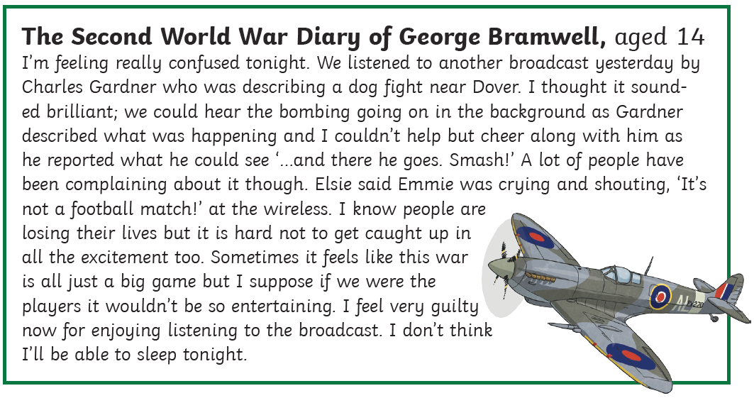
Reading Comprehension Read the following text and answer the questions on the next slide.

Slide 12
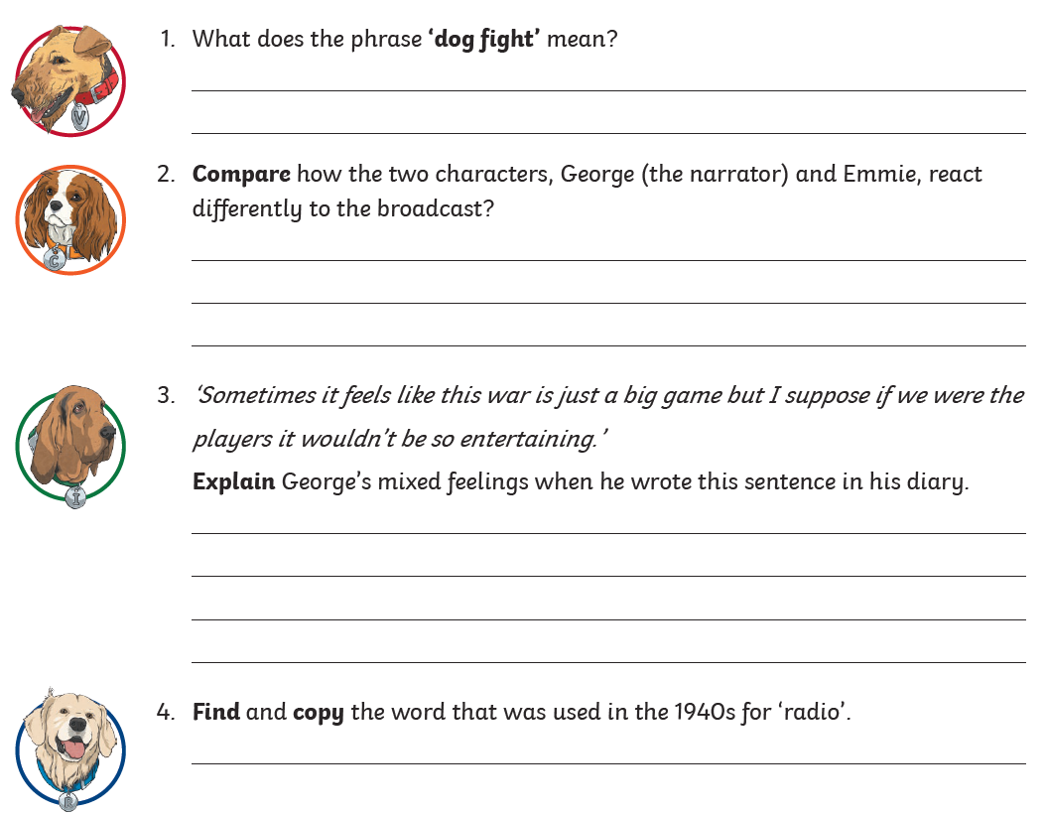

Slide 13
Music
Listen to this music from Thomas Tallis
https://www.youtube.com/watch?v=Ul8Hx1Fi-e8&list=RDUl8Hx1Fi-e8&start_radio=1
Answer the following questions:
What instruments do you hear?
Are there any changes in tempo, dynamics, or pitch? Why do you think this is?
What mood do you think it is conveying?
How does it make you feel? Why?

Slide 14
RE/Computing
Log on to Purple Mash
There is a ‘To Do’ set for you to complete. You have to tell use all about what you know about Christianity and the inside of a church. If you can’t log on, create a poster telling us all about what you know about Christianity.
We will look at this in our first RE lesson back at school as we begin our new unit.

