Slide 1
Tuesday 6th January 2026
Please find below some activities to complete.

Slide 2
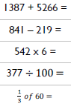

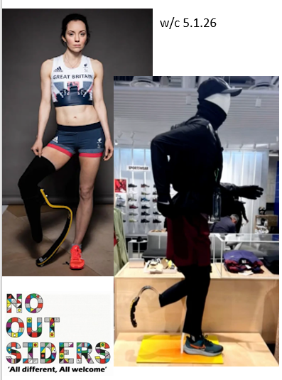
6.1.25 Daily Dashboard
Words of the week
Referee preference
Transference difference
Put the words into alphabetical order.
No outsiders
Why do you think some stores are using mannequins with blades like these, what are they trying to show people?
Think about how shoes are usually sold, what do you think Stef wants the stores to do differently?

Slide 3
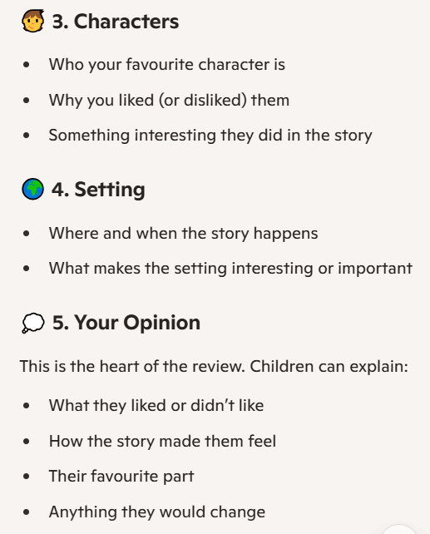
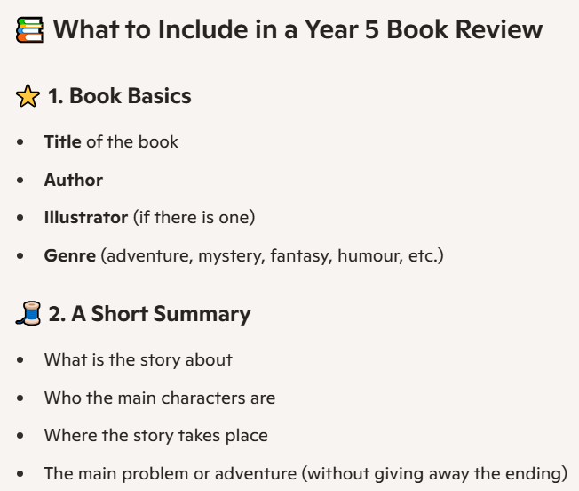
ENGLISH:
What are you reading at the moment? Did you get any new books for Christmas?
Write a review of your current book or a book you have
read recently that you would recommend to others.

Slide 4
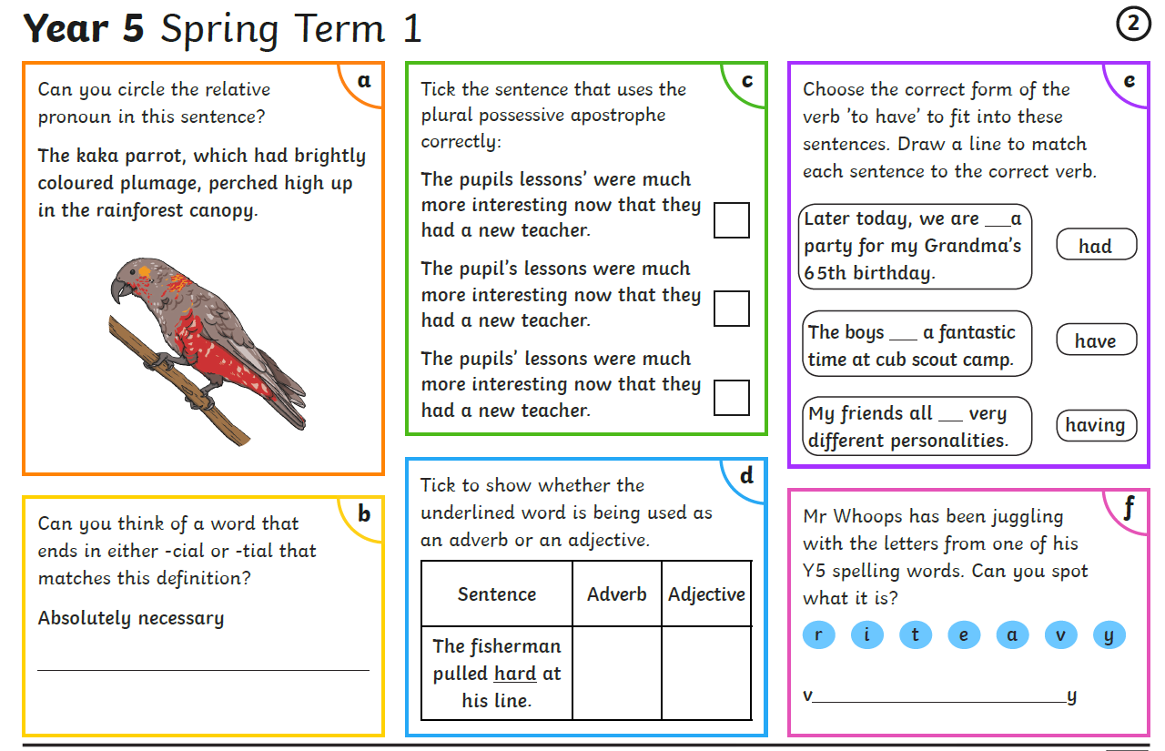

Slide 5
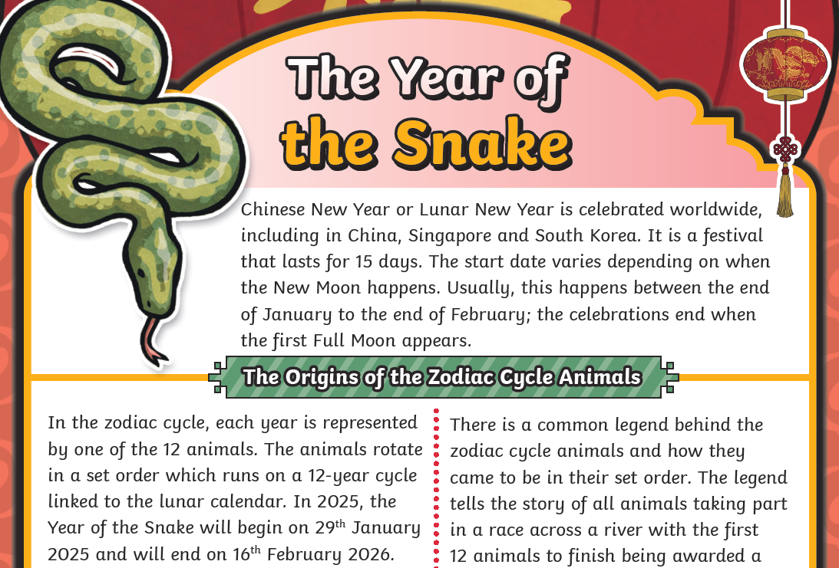
Reading comprehension:

Slide 6
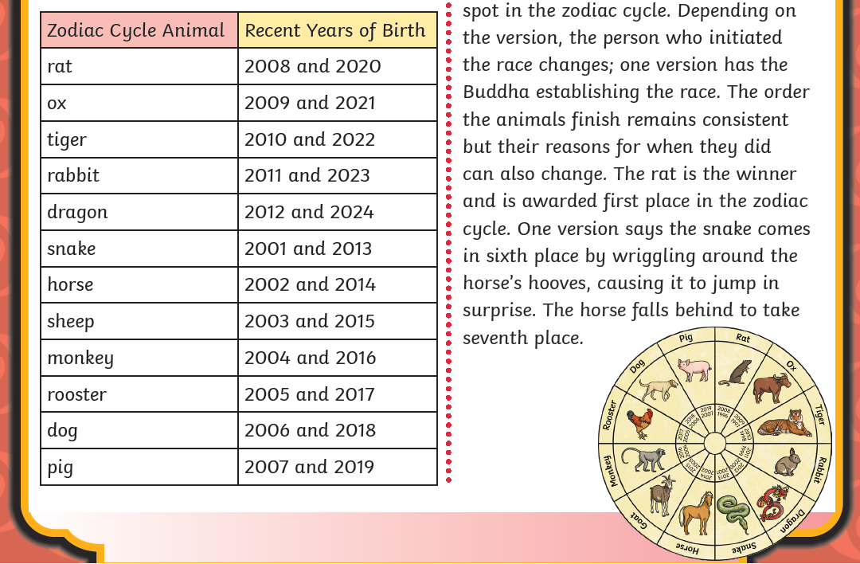

Slide 7
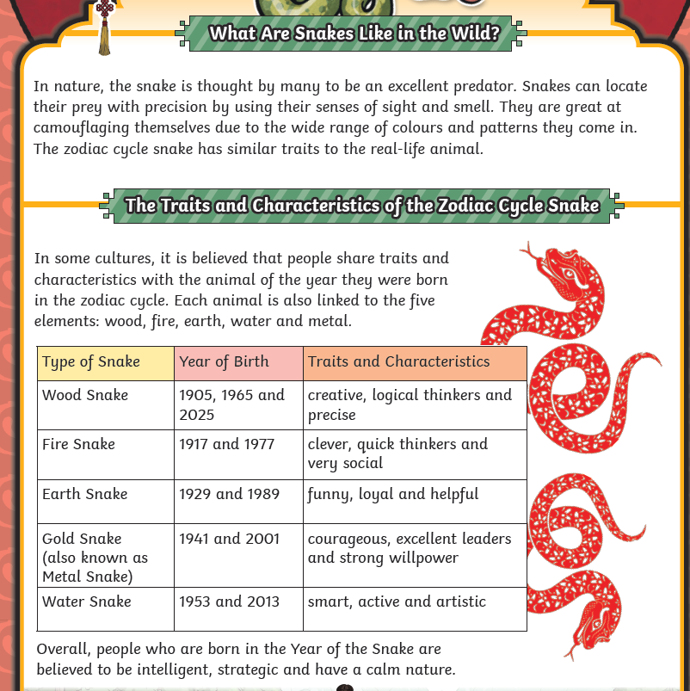

Slide 8
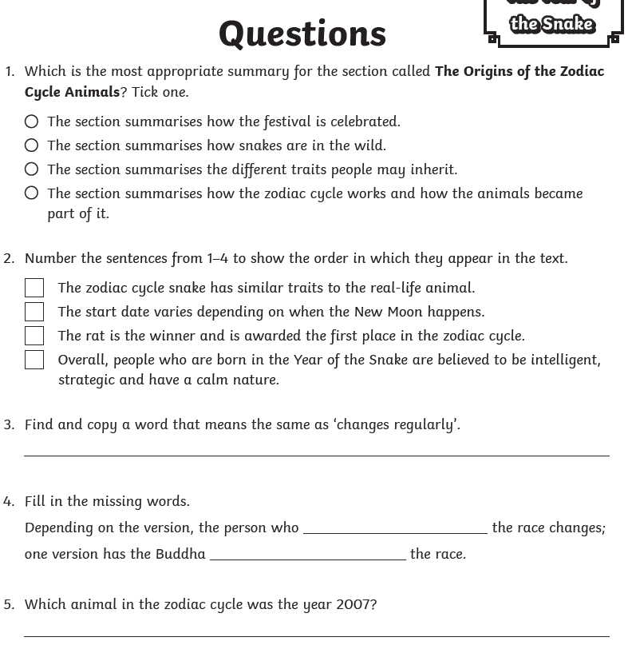
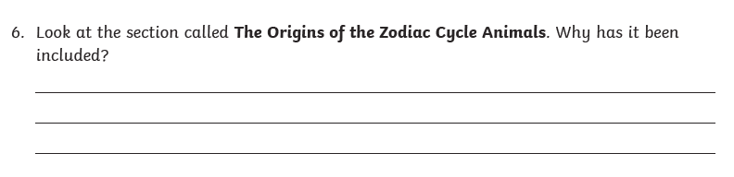
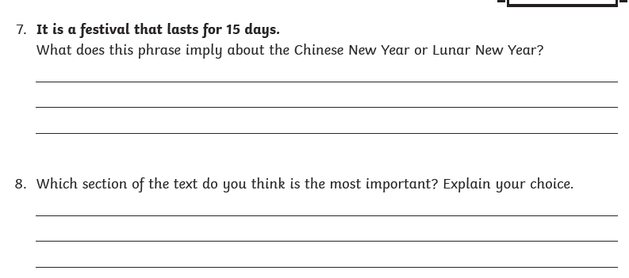

Slide 9
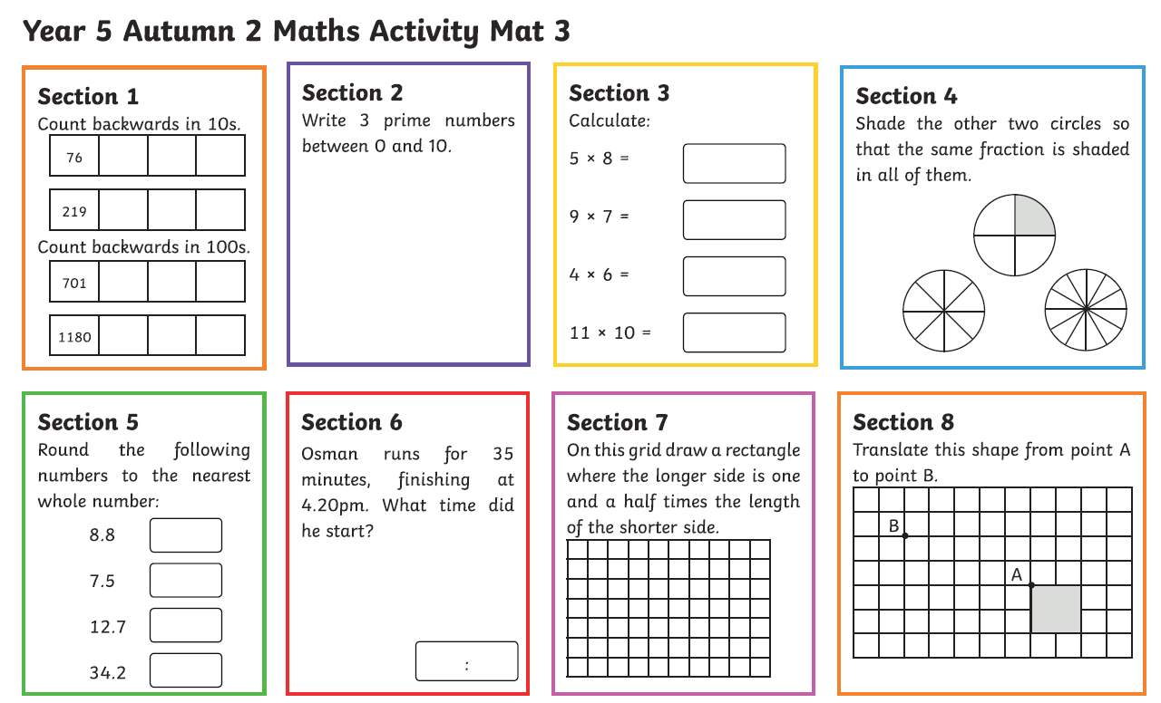
Maths-
Log in to Times Table Rockstars and practise your times tables and speed.

Slide 10
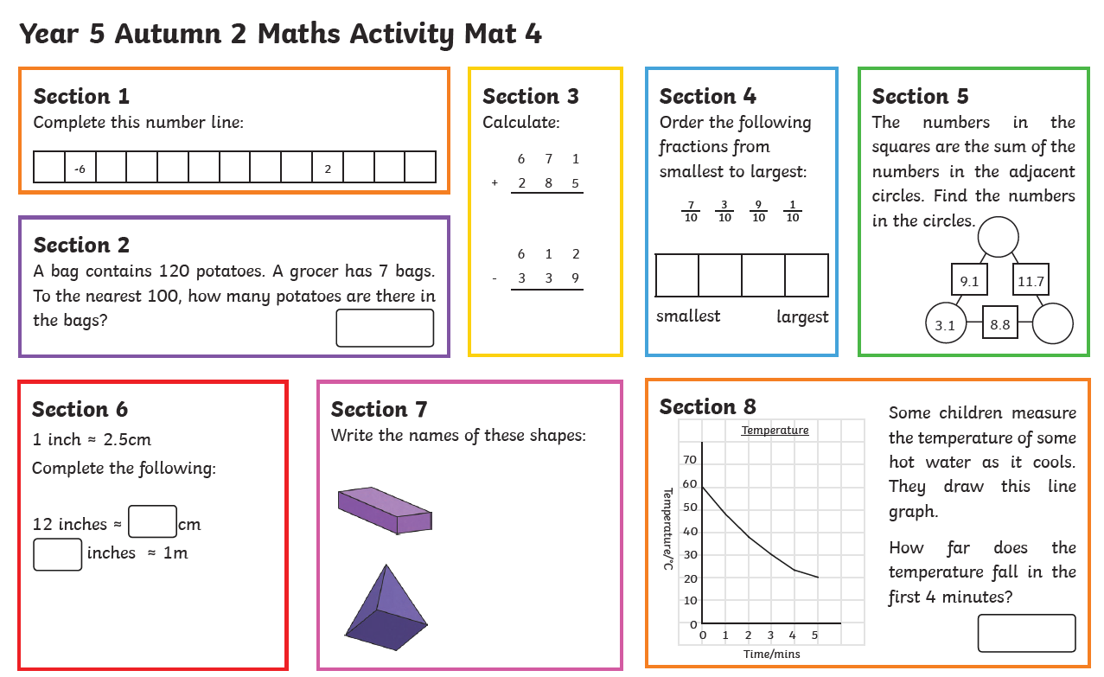

Slide 11
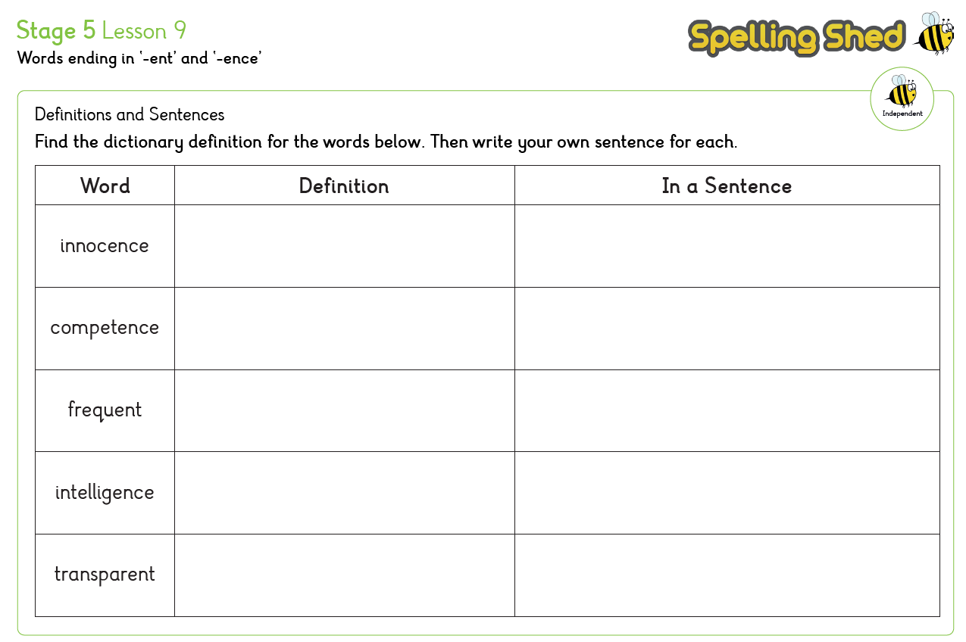
Spelling:

Slide 12
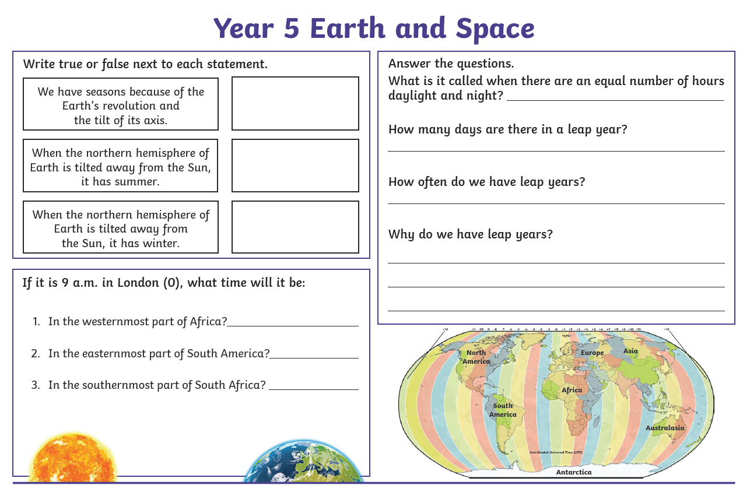
Science:

Slide 13
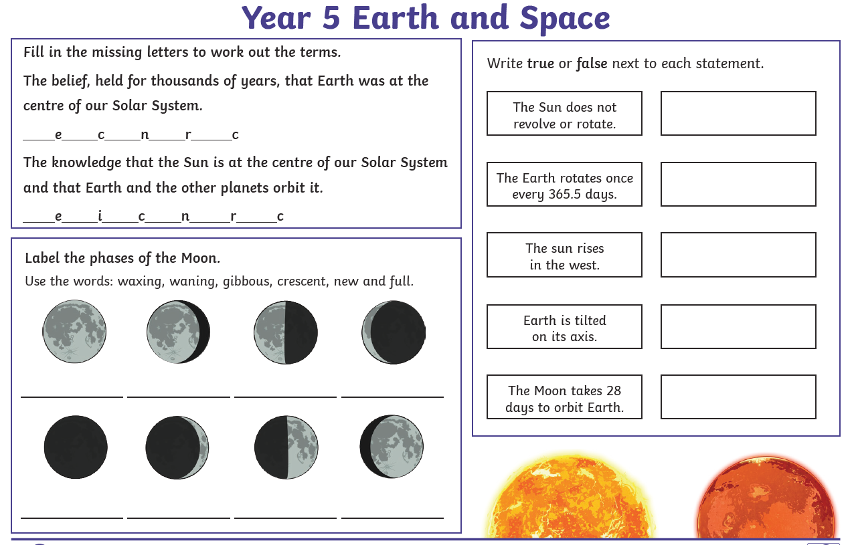

Slide 14
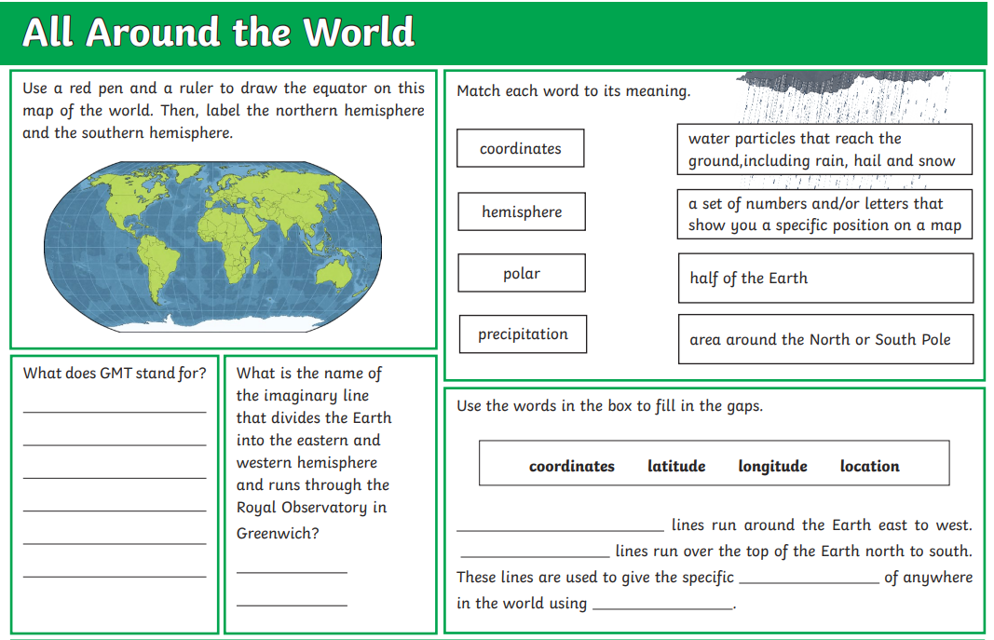
Geography:

Slide 15
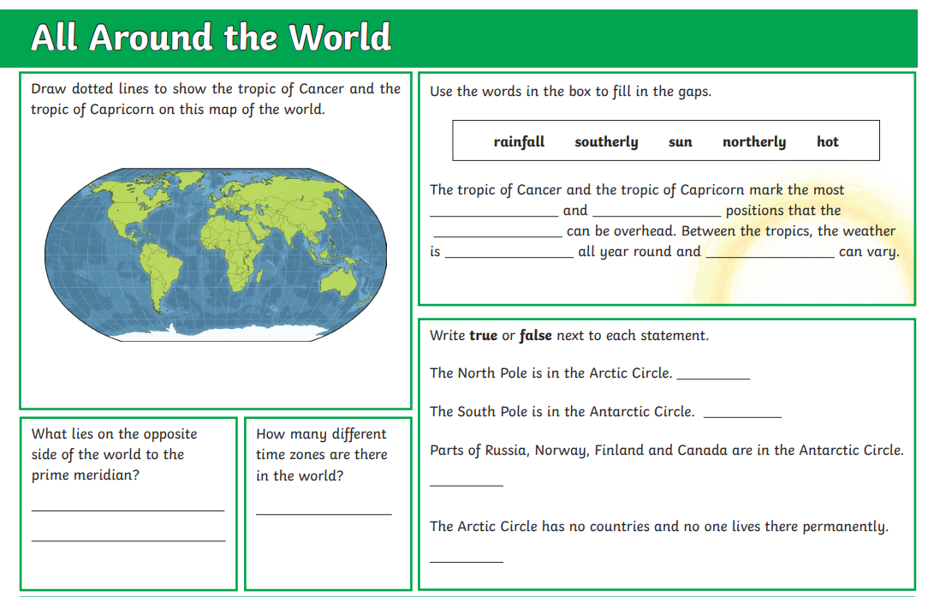

Slide 16
