Slide 1
Tuesday 6th January

Slide 2
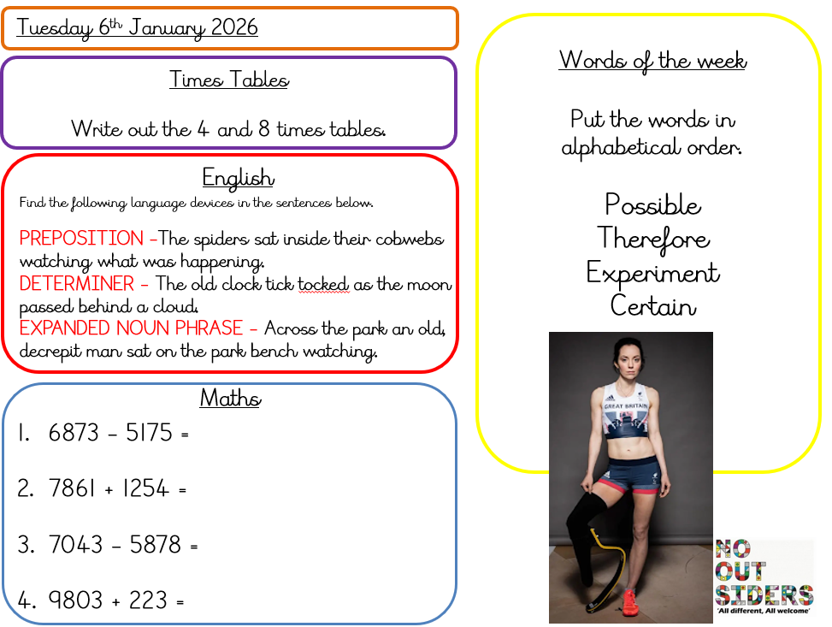
Daily dashboard
Complete you work on a piece of paper

Slide 3
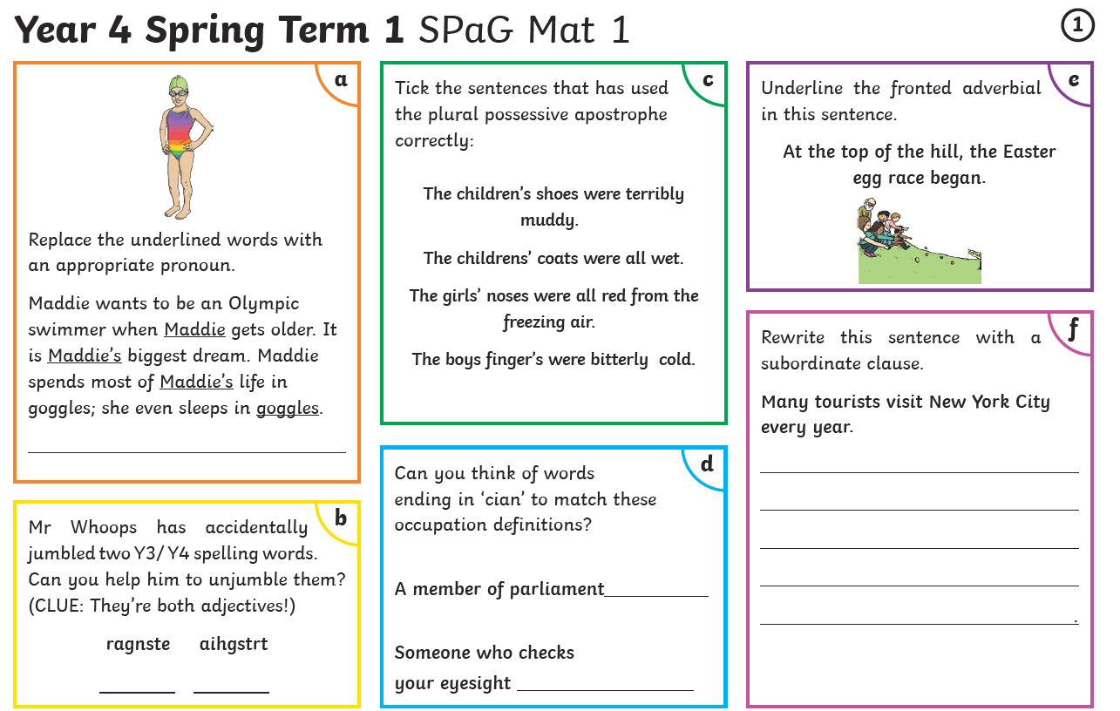
English
Complete you work on a piece of paper

Slide 4
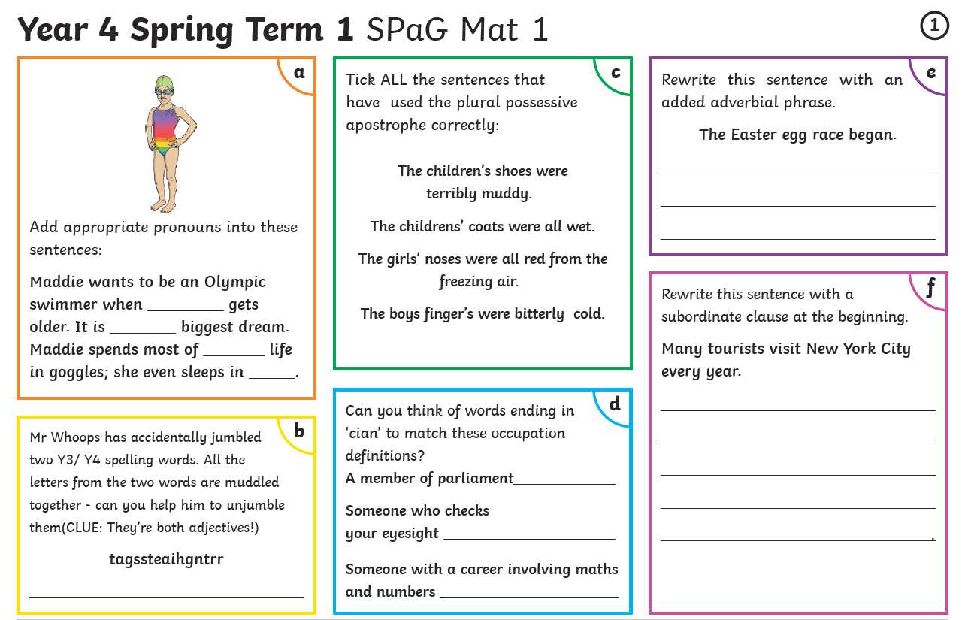
English
Complete you work on a piece of paper

Slide 5
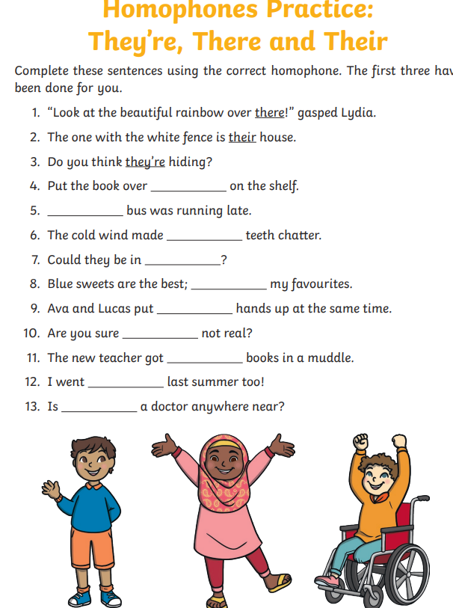

Spelling
Discuss with an adult which they’re, their or there you would use for each sentence. Can you come up with some more sentences of your own?

Slide 6
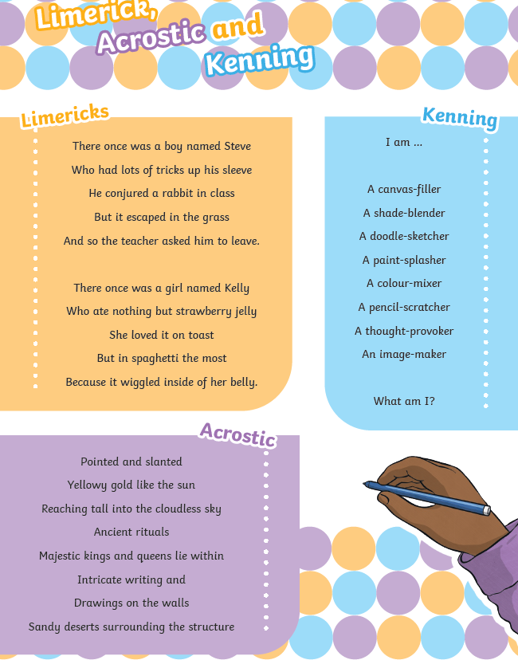
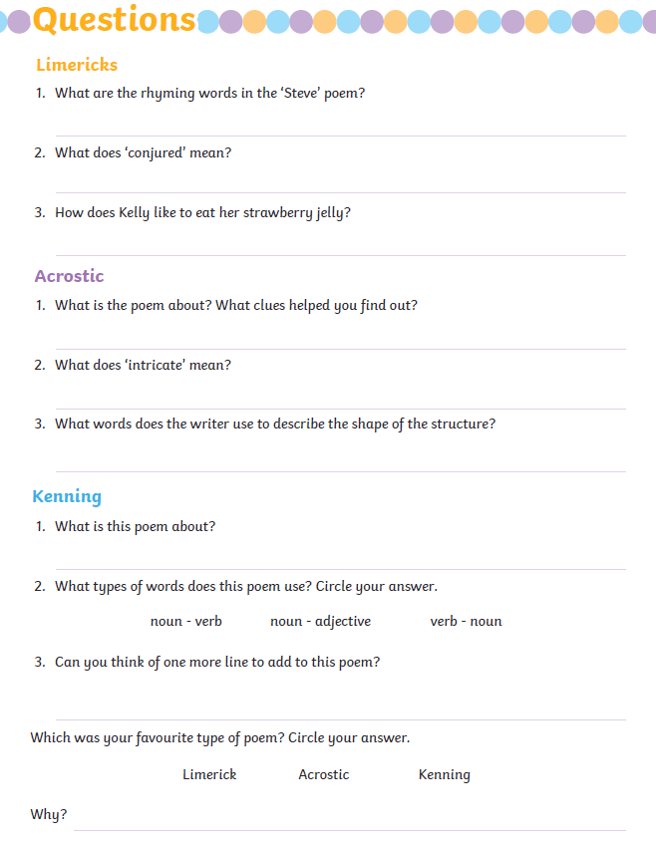
Guided reading
Read these poems and answer the questions on paper

Slide 7
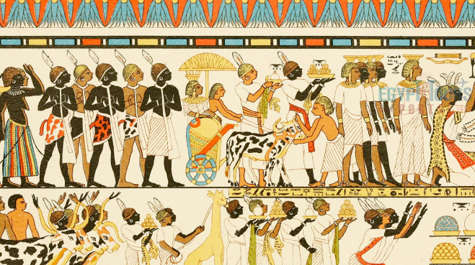
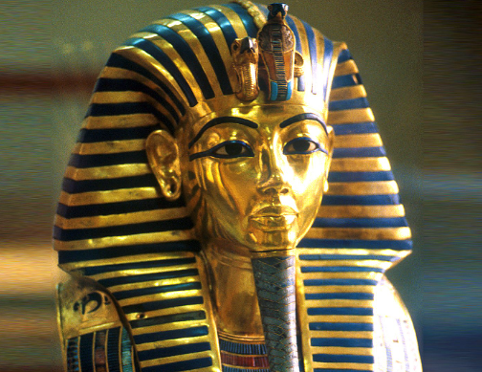
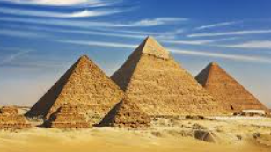
History – Egyptians
Make a poster about everything you leant about the Egyptians. We can share them at school.

Slide 8
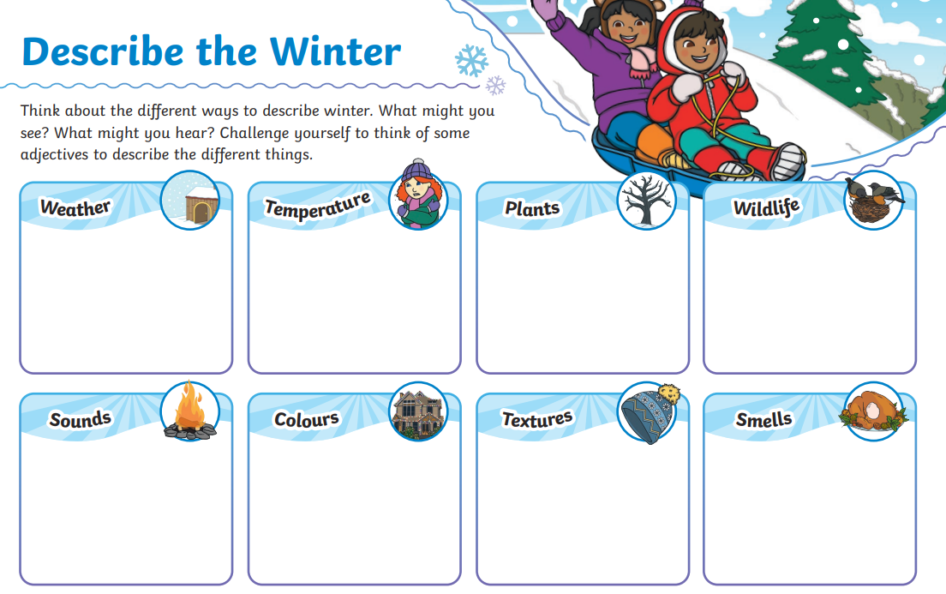
Snow activity Explore outside to help you with thinking of adjectives to describe Winter

