Slide 1
Tuesday 6th January 2026

Slide 2
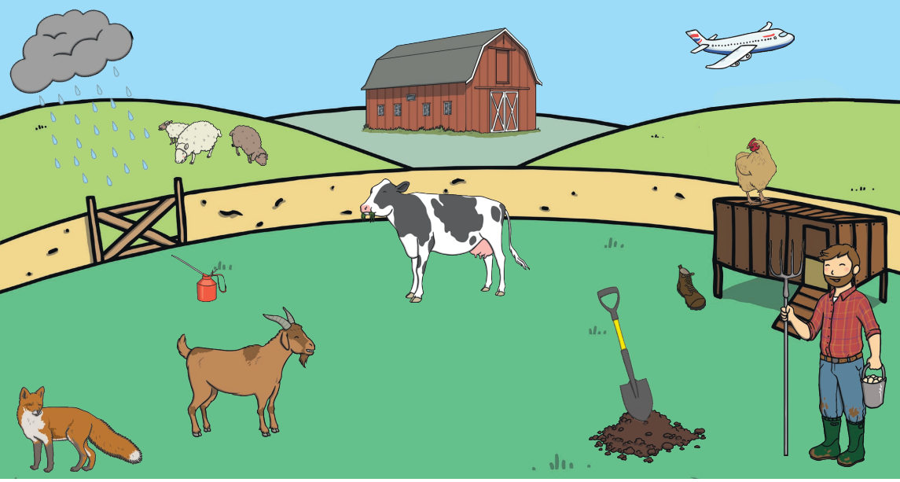
Phonics What can you see in the picture? Write labels that could be added.

Slide 3
Reading Read / share a book with an adult. What was your favourite part? Record your answer in your reading diary.

Slide 4
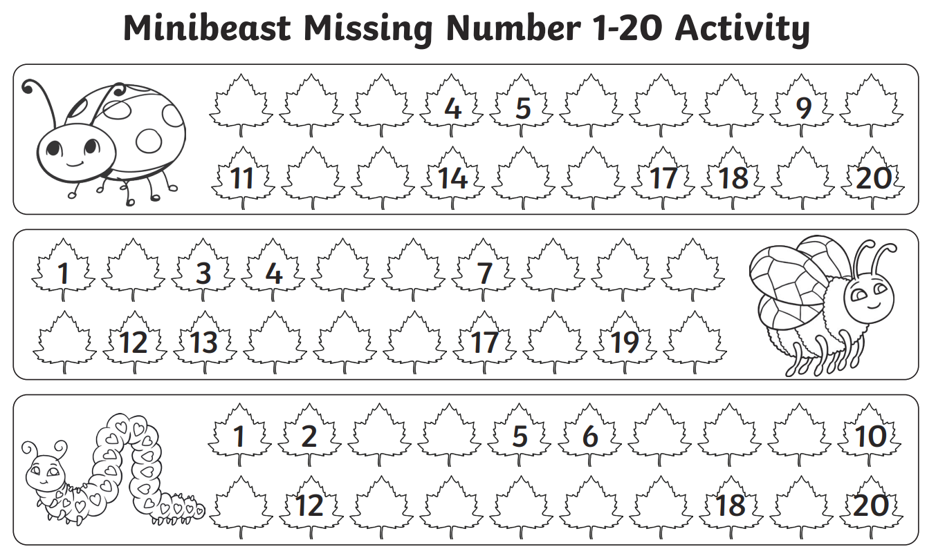
Maths
What are the missing numbers?

Slide 5
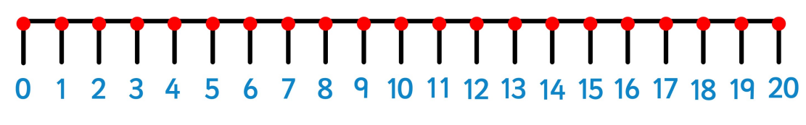
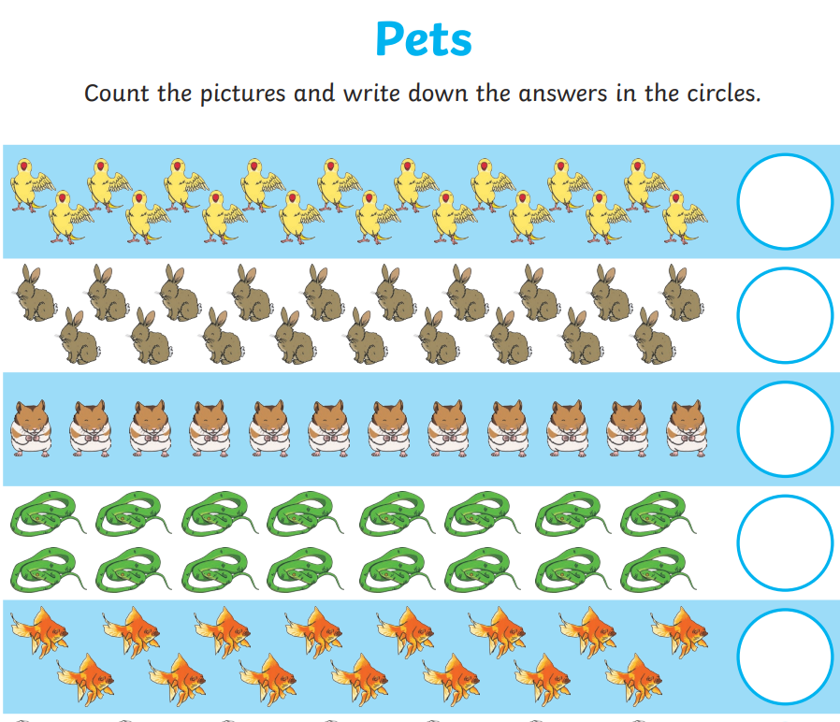

Slide 6
Can you draw the correct number of each items of my shopping list?
5 sweets
17 grapes
13 apples
20 pencils
2 books
16 mugs
14 biscuits

Slide 7
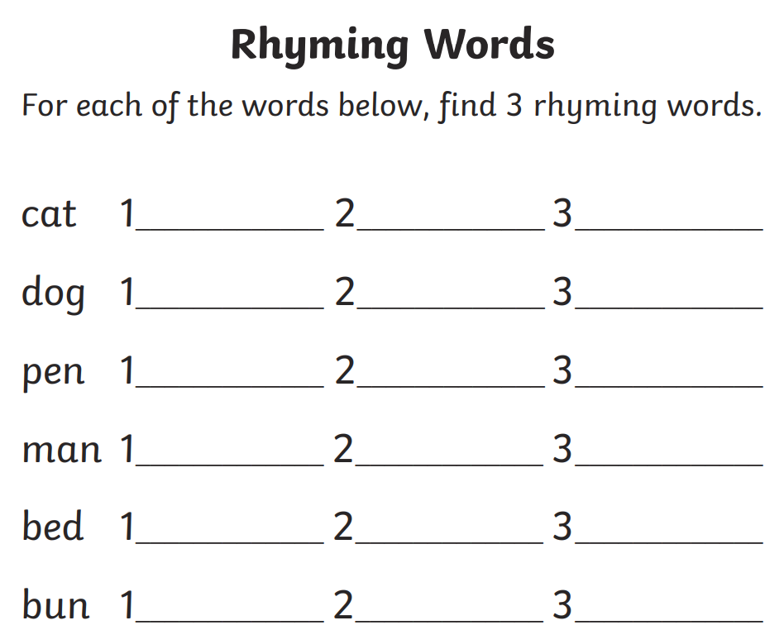
English Challenge: Write the word in a sentence.

Slide 8
Computing. Use Purple Mash – logins are in your Reading Diaries. Complete the tasks in your To Do folder.

Slide 9
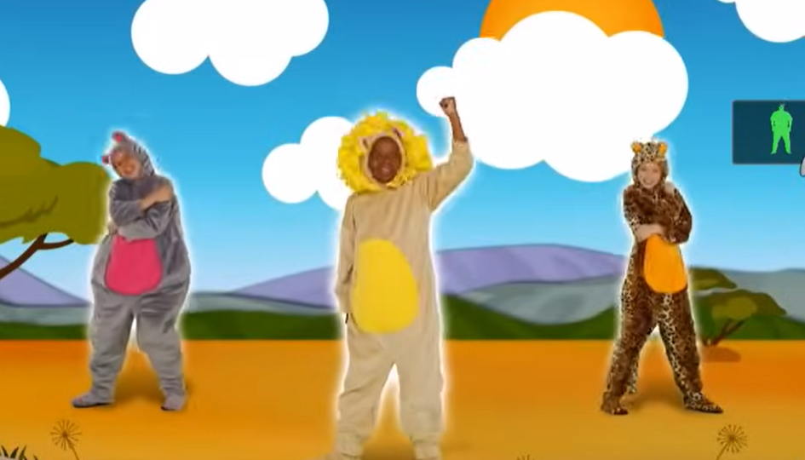
PE Complete some exercise at home. Maybe you would like to do a Just Dance like we enjoy at school? https://www.youtube.com/watch?v=ziLHZeKbMUo

